Slide 1







Deep Learning with Keras with TensorFlow

Slide 2
Introduction to AI and Deep Learning

Slide 3

By the end of this lesson, you will be able to:
Describe artificial intelligence and deep learning
Outline the history of artificial intelligence
List successes of deep learning
Discuss object detection using self-driving cars
Discuss the applications of deep learning
Outline the life cycle of a deep learning project

Slide 4
Artificial Intelligence

Slide 5
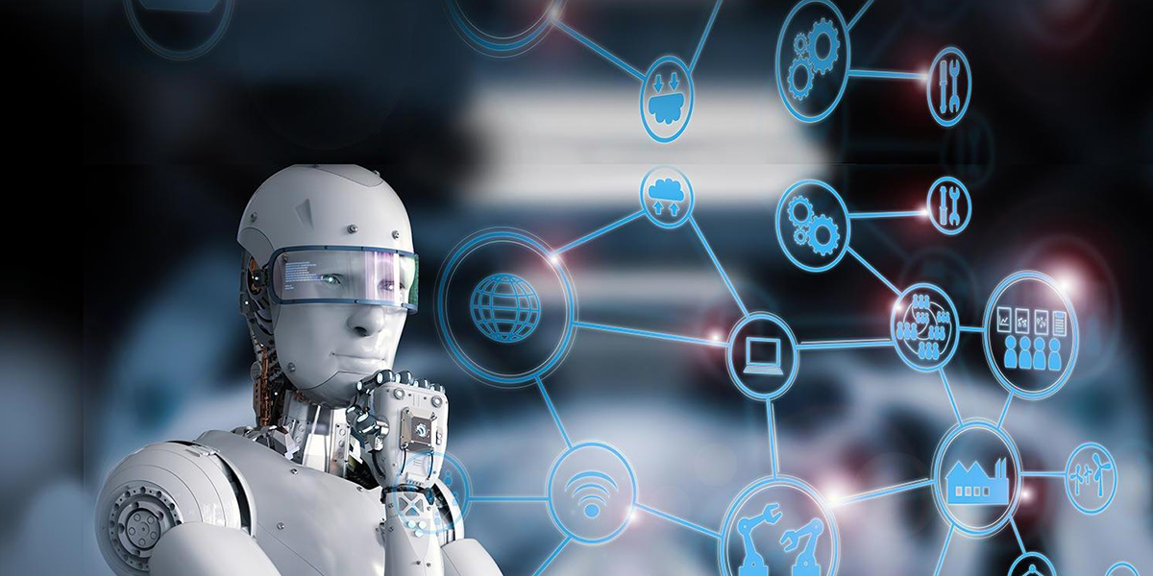
Artificial Intelligence
Artificial intelligence (AI) is a branch of computer science that attempts to simulate human intelligence in machines.

Slide 6

Artificial Intelligence
For a machine to be classified as AI, it must perform the tasks given below:
Learn
Acquire data and rules
Reason
Draw conclusions using the rules
Self Correct
Correct itself without external assistance

Slide 7
History of AI

Slide 8
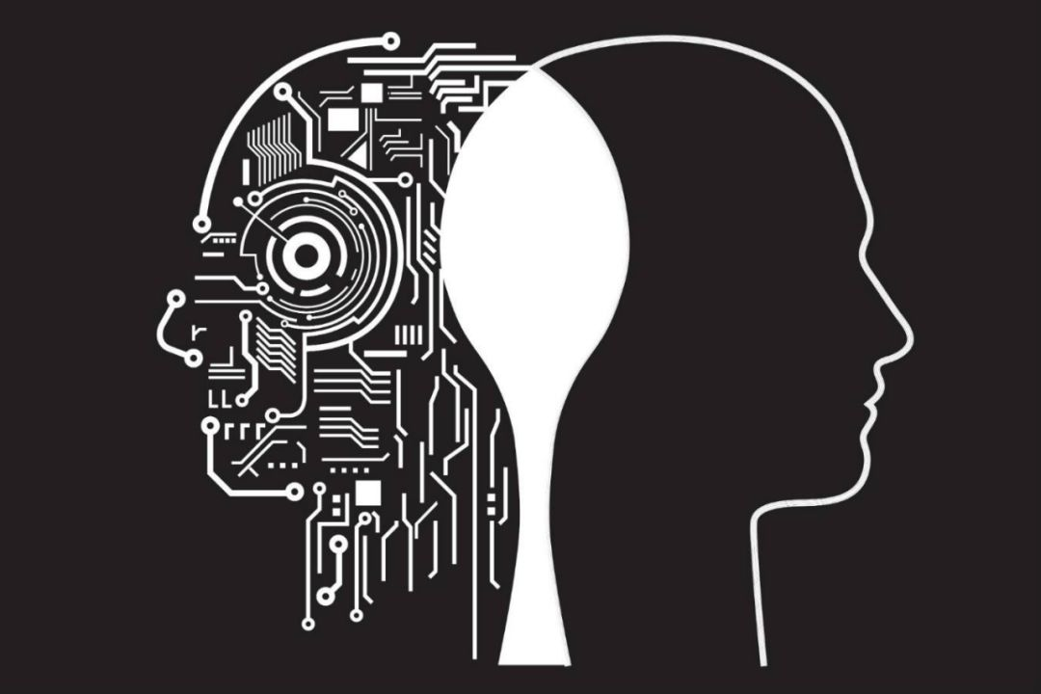
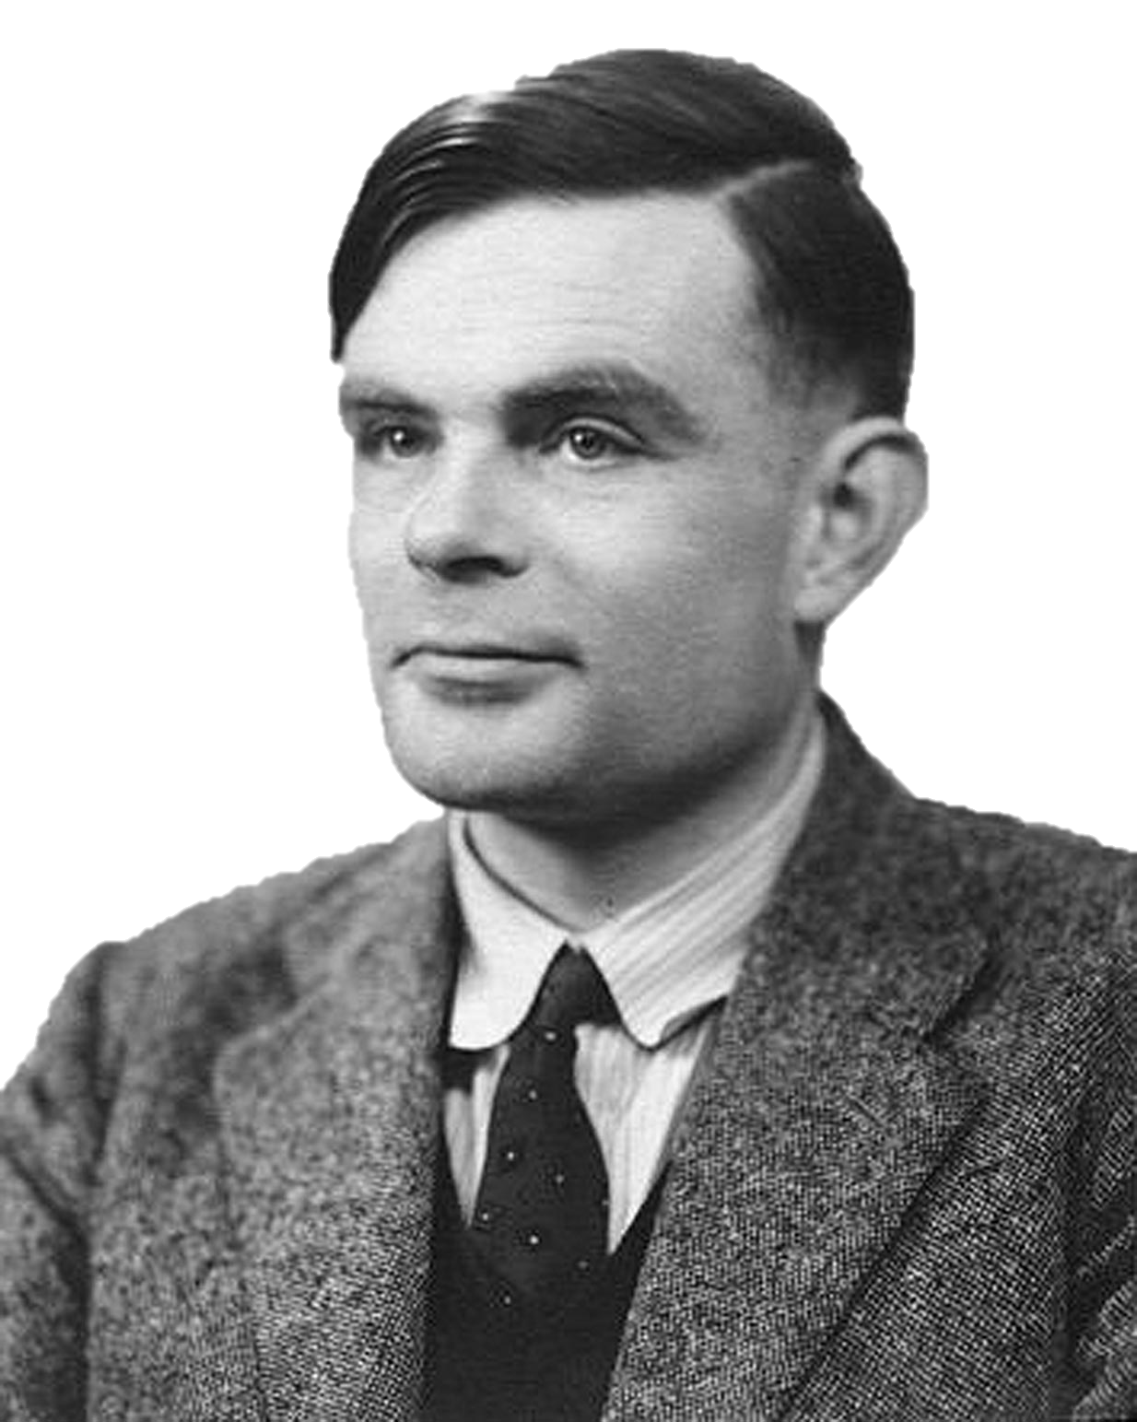
The Turing Test
In 1950, Alan Turing wrote a paper proposing a test that looked at whether a computer can think like a human being.
Turing
test
“ Can machines think ? ”
The paper focused on answering the question, "Can machines think?"

Slide 9
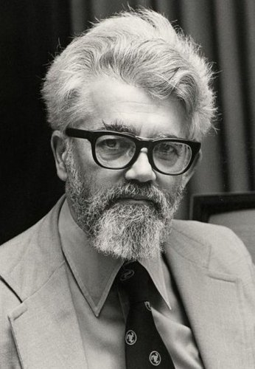
Father of AI
In 1955, John McCarthy coined the term “Artificial Intelligence” in a conference at Dartmouth.
He was very influential in the early development of AI and also helped develop the Lisp programming language.

Slide 10

Rise of AI: 1956−1974
The years after the conference in Dartmouth were the most crucial period in AI development and discovery.
DARPA-developed computers solved algebra word problems, proved theorems, and learned to talk English.

Slide 11
1980s–2000s
1986
1
Rise of Machine Learning
Neural networks return to popularity
Major advances in ML algorithms and applications
1995
2
AI as Science
Vision, language, and information mining techniques gain popularity
2006
3
Face Recognition
Consumer cameras offer face recognition software

Slide 12
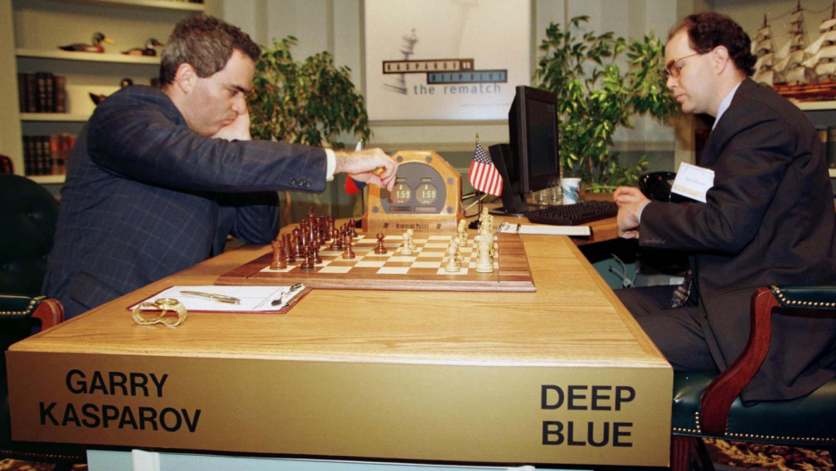
Man vs. Machine
Garry Kasparov was defeated by Deep Blue chess computer in 1997.
This was the first time a computer won over a reigning world chess champion.

Slide 13
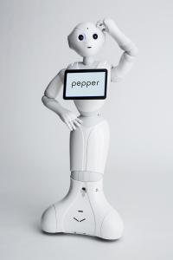
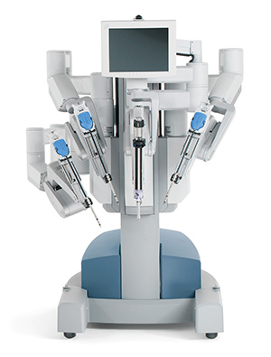
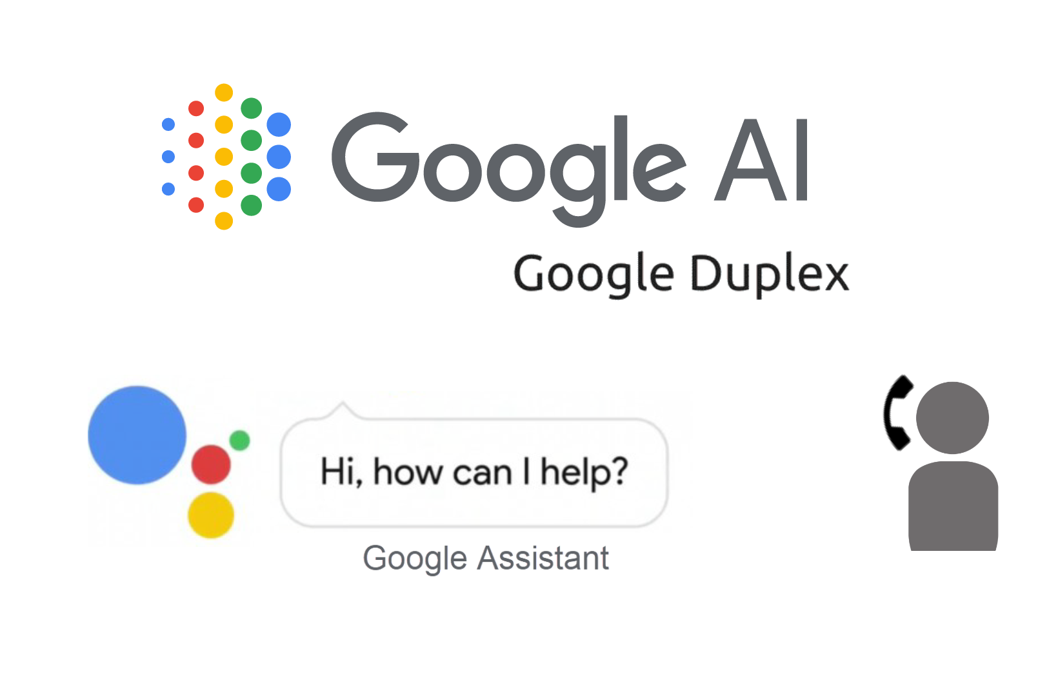
State of AI
Artificial Intelligence is already proliferating in our lives. For example:
Pepper Can recognize human faces and basic emotions
Da Vinci® Surgical Systems Can perform minimally invasive surgeries
Google Duplex
Can make reservations or appointments, over the phone

Slide 14
What Can AI Do?
Here are some problems best suited for AI to solve:
Superhuman Tasks
Tasks that are very challenging for humans but easy for machines
Repetitive Tasks
Manual tasks that follow logical steps to lead to a conclusion
03
01
02
Data-Intensive Tasks
Tasks involving analyzing large amounts of data
and looking for patterns and anomaly

Slide 15






Advantages of AI
Error Reduction
With incredible precision, accuracy, and speed, AI has a low error rate compared to humans.
Medical Applications
AI has a significant application in early detection and monitoring of various diseases.
Digital Assistants
AI can assist users in their daily chores and activities.
Repetitive Jobs
Machines think faster than humans and can perform repetitive jobs swiftly.
Difficult Explorations
AI can work in hostile environments that would injure or kill humans to complete dangerous tasks and endure problems.
No Breaks
Machines, unlike humans, don't need to sleep, rest, take breaks, or get entertained.

Slide 16
Limitations of AI
1
Very challenging to capture all traits of human intelligence
2
Current focus of development lies with lucrative domain specific applications
3
Limited ability with respect to the diversity of domain problems
4
Unpredictability or failure in emergency situations
5
High cost for R&D and production

Slide 17
Recap: Machine Learning

Slide 18



Types of Machine Learning
Machine learning comprises three primary techniques:
Machine
Learning
Supervised
Unsupervised
Reinforcement
Task Driven
(Predict Next Value)
Data Driven
(Identify Clusters)
Learn from
Mistakes

Slide 19


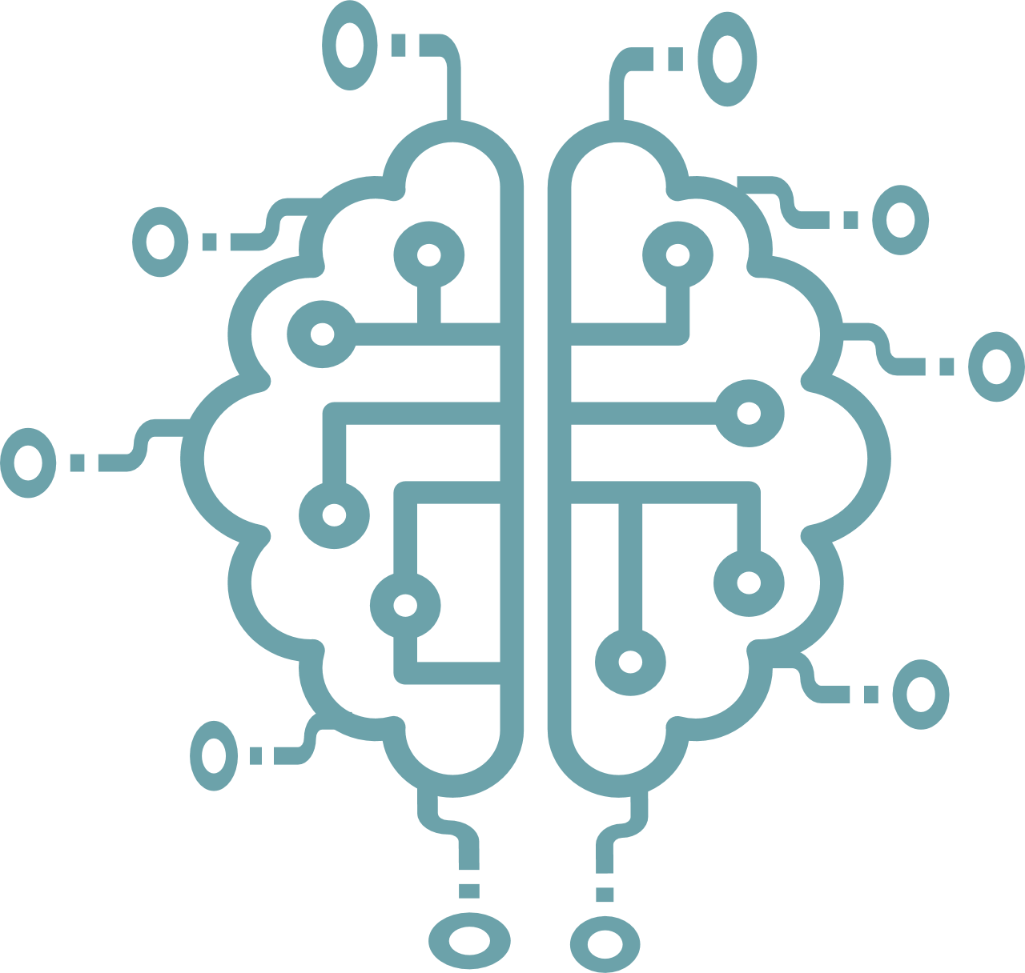



Supervised Learning
The goal of supervised learning is to build a mapping function (f) that takes the input data (x) and predicts the output data (Y).
“CATS”
Label
“CATS”
“NOT CATS”
MACHINE
MACHINE
Step 1: Provide labeled input and output to train
Step 2: Provide new unlabeled data to test
The mapping function (f) has to achieve a certain level of performance to be considered fit for production.

Slide 20
Types of Supervised Learning
There are two types of supervised learning depending on the type of the output variable.
Output
Variable
Categorical
Numerical
Classification
Regression
Sorting items into categories
Identifying real values

Slide 21
Supervised Learning Algorithms
A list of supervised machine learning algorithms include:
Linear Regression
Logistic Regression
Support Vector Machines
Naive Bayes
Decision Trees
Linear Discriminant Analysis

Slide 22
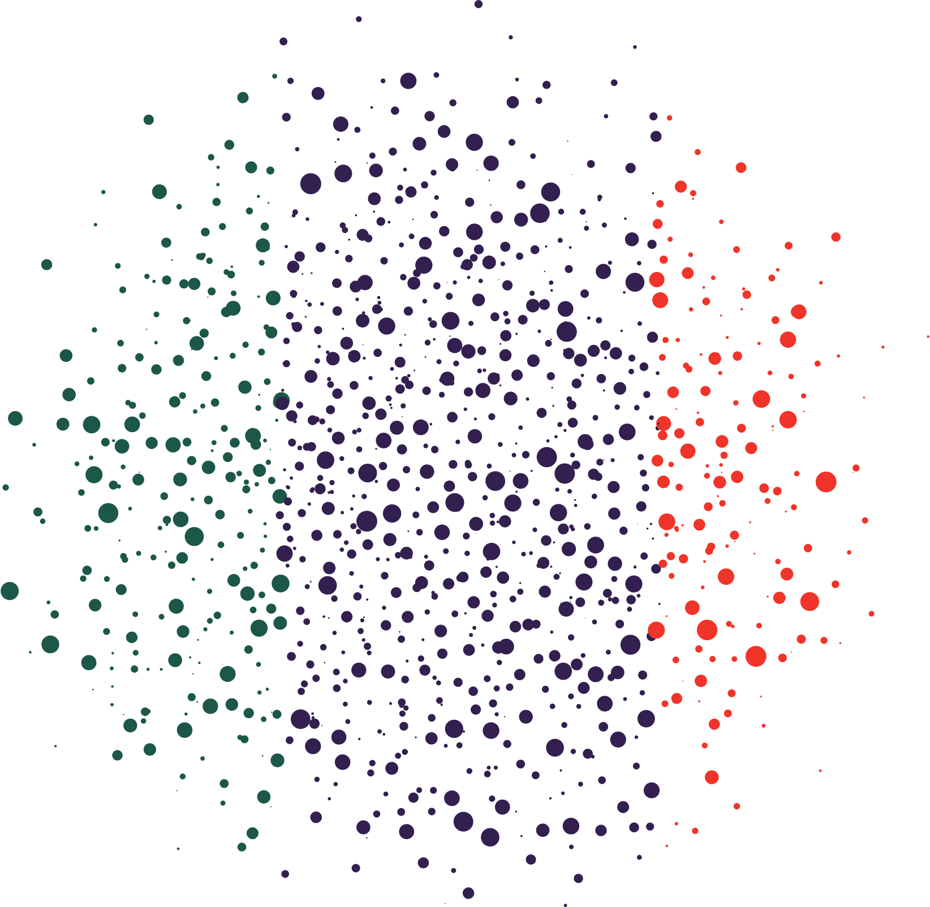




Unsupervised Learning
In unsupervised learning, only the inputs are known and the model is trained on the inputs to find the underlying patterns in the data.
Input Raw Data
Algorithm
Output
Unknown Output
No Training DataSet
Interpretation
Processing

Slide 23
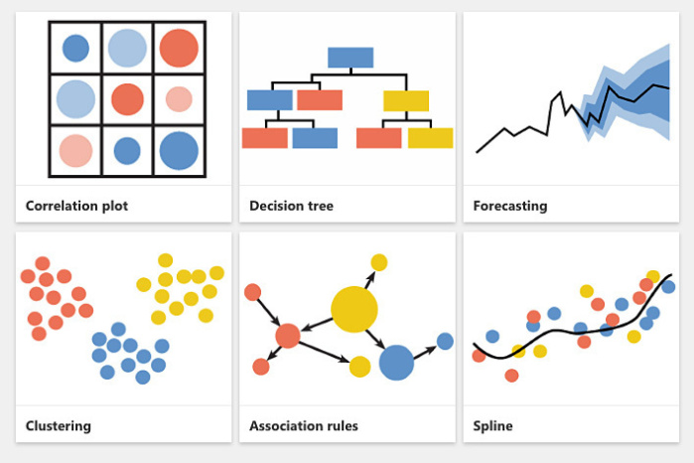
Types of Unsupervised Learning
Unsupervised learning is classified into two categories of algorithms:
Clustering
Association
Discover groups inside the input data
Discover rules inside the input data

Slide 24
Unsupervised Learning Algorithms
A list of unsupervised machine learning algorithms include:
K-means Clustering
Apriori Algorithm
Hierarchical Clustering
Principal Component Analysis
Density-Based Spatial Clustering of Applications with Noise (DBSCAN)
Non-Negative Matrix Factorization

Slide 25


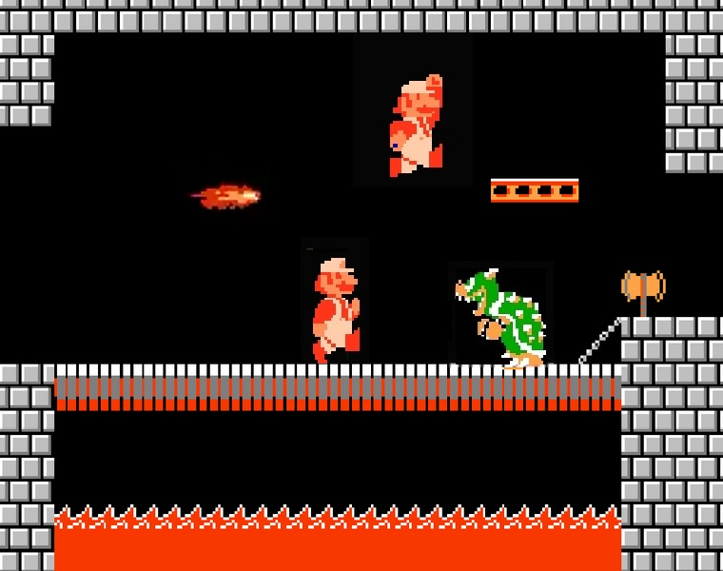
Reinforcement Learning
Reinforcement learning agents are goal-oriented. They learn by trial and error in an environment that provides rewards or penalties in response to the agents’ outputs.
Goal
State and Reward
Agent
Environment
Actions
The aim is to find the best path that maximizes the likelihood of winning reward.

Slide 26
Types of Reinforcement Learning
There are two types of reinforcement learning:
Clustering
Positive Reinforcement
Desirable stimulus is added to increase the likelihood of a behavior.
Negative Reinforcement
Undesirable stimulus is removed to increase the likelihood of a behavior.

Slide 27
Reinforcement Learning Algorithms
A list of reinforcement machine learning algorithms include:
Monte Carlo
Q-Learning
State–Action–Reward–State–Action (SARSA)
Deep Q Network
Q-Lambda
SARSA-Lambda

Slide 28
Deep Learning

Slide 29



ML vs. DL
Deep Learning is a subset of Machine Learning and is used to extract useful patterns from data.
Machine
Learning
Car
Not Car
Input
Feature Extraction
Classification
Output
Machine Learning models need human intervention to arrive at the optimal outcome.
Deep
Learning
Car
Not Car
Input
Feature extraction and Classification
Output
Deep Learning models make predictions independent of human intervention.

Slide 30



AI vs. ML vs. DL
ARTIFICIAL
INTELLIGENCE
A technique which enables machines to mimic human behavior
MACHINE
LEARNING
Subset of AI technique which use statistical methods to enable machines to improve with experience
DEEP LEARNING
Subset of ML which makes the computation of multi-layer neural network feasible

Slide 31
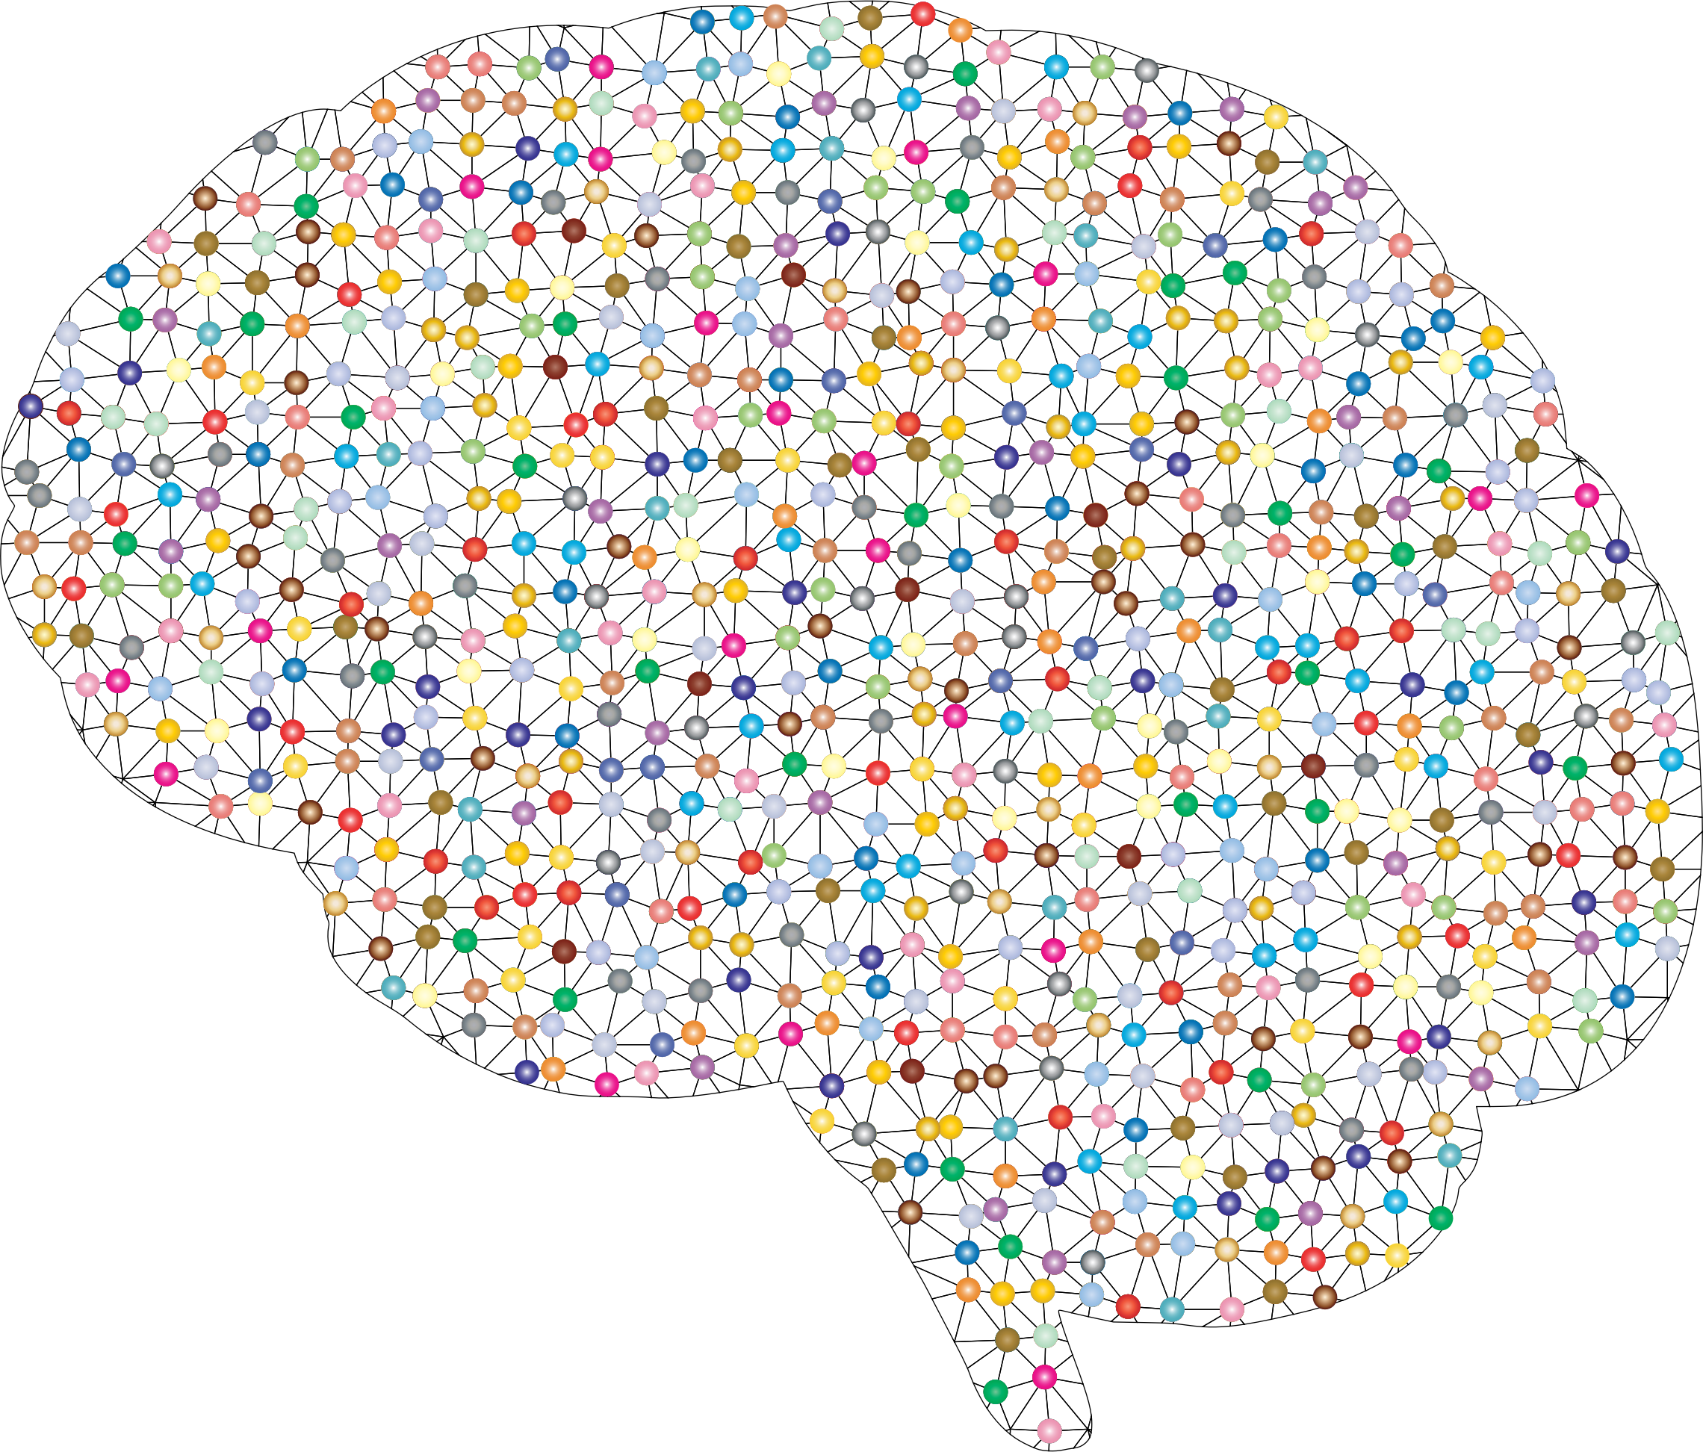
Neural Networks
Deep Learning models utilize artificial neural networks (ANN) that are inspired by the biological neural network of the human brain.
Notes:
https://www.shutterstock.com/image-vector/ai-artificial-intelligence-icon-set-706236937?id=706236937&irgwc=1&utm_medium=Affiliate&utm_campaign=Freepik+Company%2C+S.L.&utm_source=39422&utm_term=5d62c34a657e4.5d62c34a657e5

Slide 32
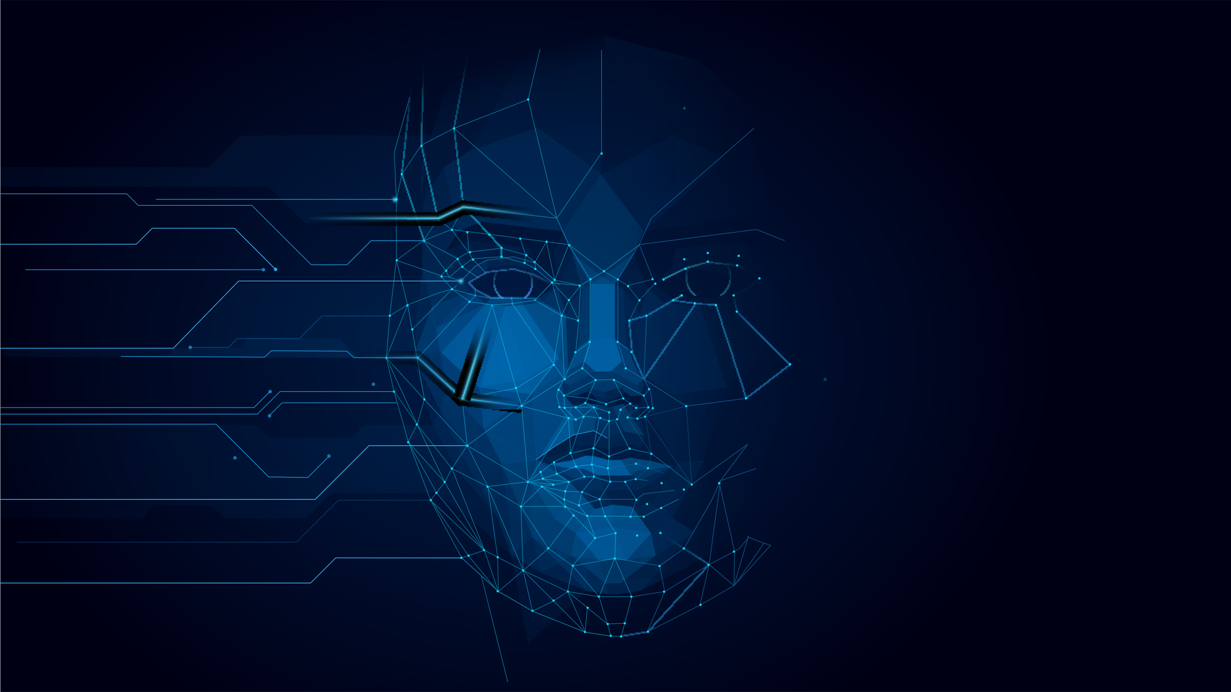



Artificial Neural Network (ANN)
ANNs try to imitate neuronal activity in the brain in order to learn to recognize data patterns.

Slide 33
Deep Learning
The deep in Deep Learning refers to the large number of layers of neurons that help to learn various representations of data.
neuron
Output
(prediction)
Input
(features)
Hidden Layers
lots of layers ~ “deep learning”

Slide 34
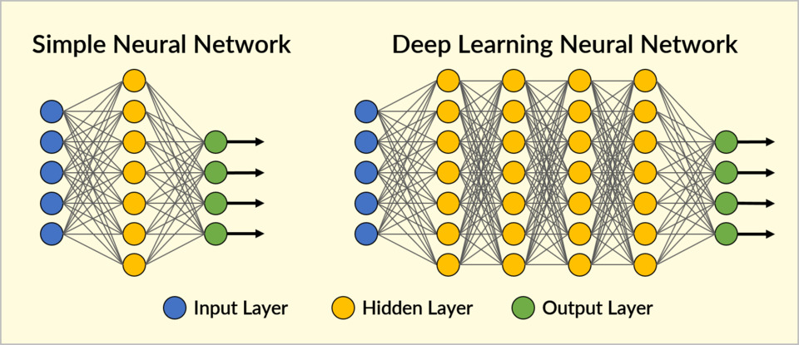
Network Architecture
One can programmatically set the number and type of neural layers and the number of neurons comprising each layer.
Shallow neural networks consist of only 1 or 2 hidden layers.

Slide 35
Performance
Deep AI models have greater precision than conventional techniques but require more information to train and attain this precision.
Large NN
Medium NN
Model Performance
Small NN
Traditional ML Algorithms or
Statistical Learning
Data Size

Slide 36
Deep Learning: Success Stories from the Last Decade

Slide 37
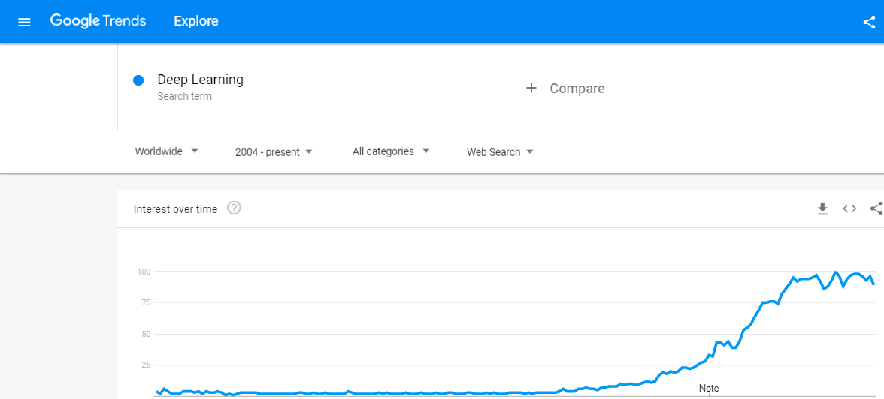
Deep Learning Search Trends
Over the past several years, people are looking for more information on deep learning.

Slide 38
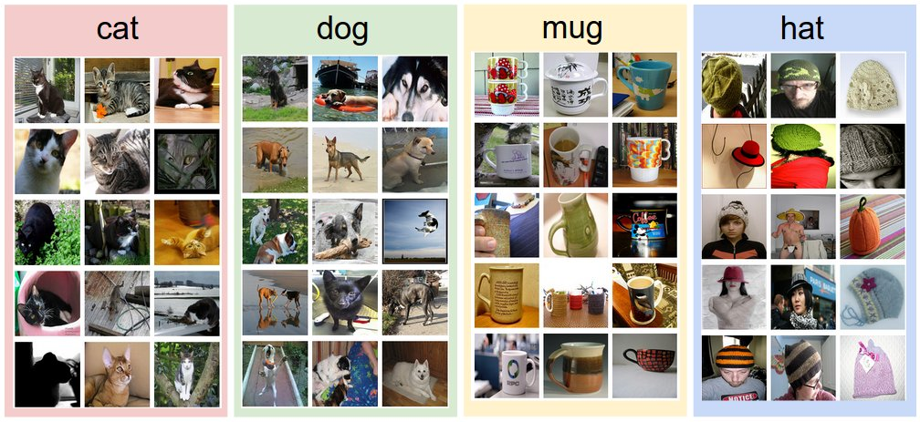
ImageNet
In 2009, a large visual database called ImageNet was created which catapulted deep learning of the 21st century.
The database has more than 14 million labeled images which can be used to train neural nets.

Slide 39
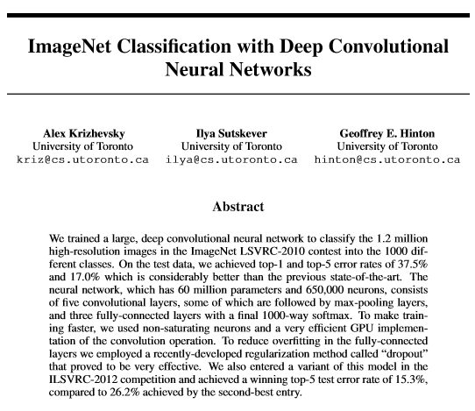
The History Began from AlexNet
In 2012, a neural network named AlexNet was trained on more than a million images from the ImageNet database. It won the ImageNet competition by a large margin.
The success of AlexNet spurred more papers and accelerated deep learning renaissance.

Slide 40
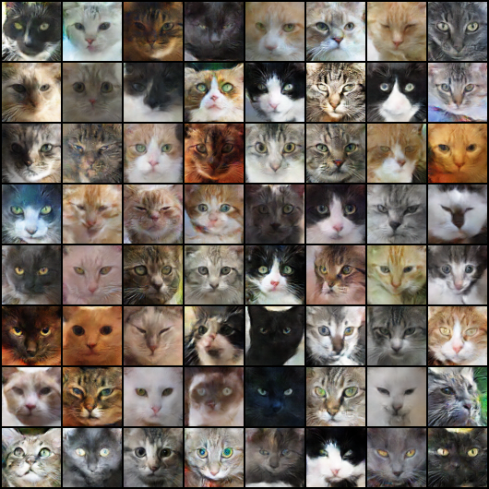

Recognizing Cats on YouTube
In 2012, Google Brain team trained its neural network to recognize cats by watching unlabeled images taken from frames of YouTube videos.
It was a 70% improvement over any other machine learning technique at the time.

Slide 41
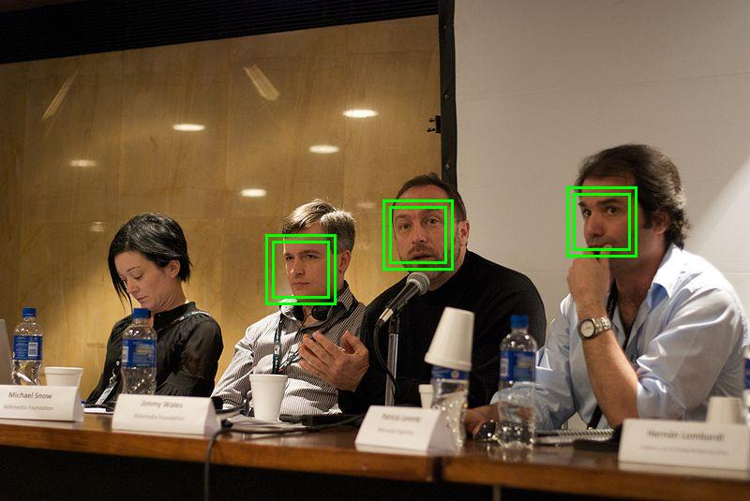
DeepFace
Facebook’s DeepFace, released in 2014, used neural networks to identify human faces with 97.35% accuracy.
The facial recognition system was trained on four million images uploaded by Facebook users.

Slide 42
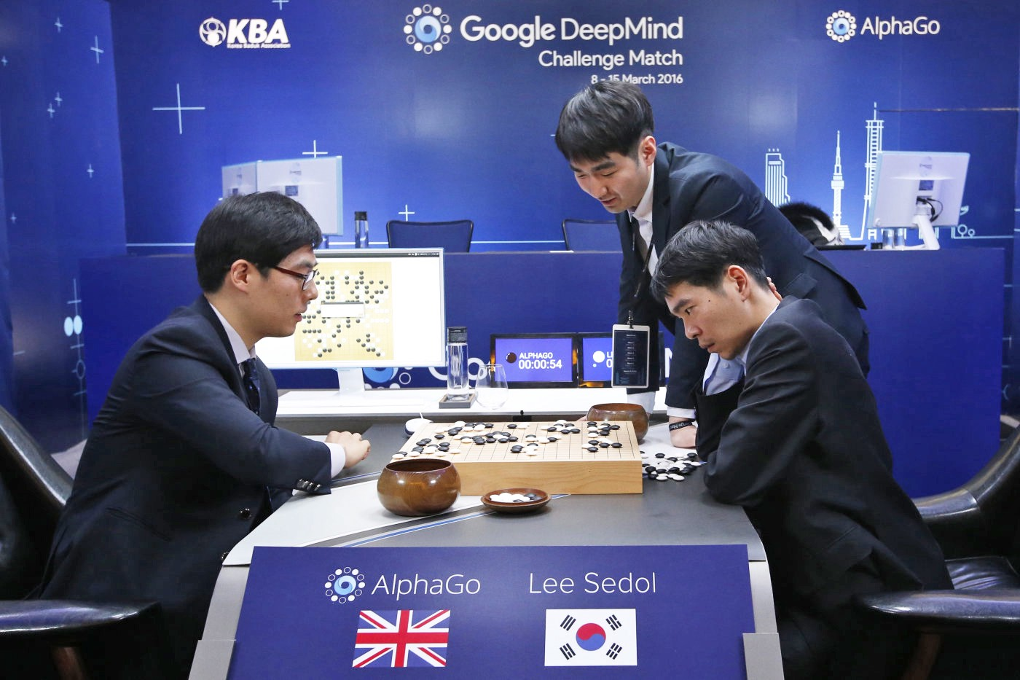
Beating Humans in Go
In 2015, AlphaGo algorithm developed by Google DeepMind becomes the first computer program to defeat a human professional.
The second version, AlphaGo Zero defeated the 18-time world champion Lee Sedol very easily.

Slide 43
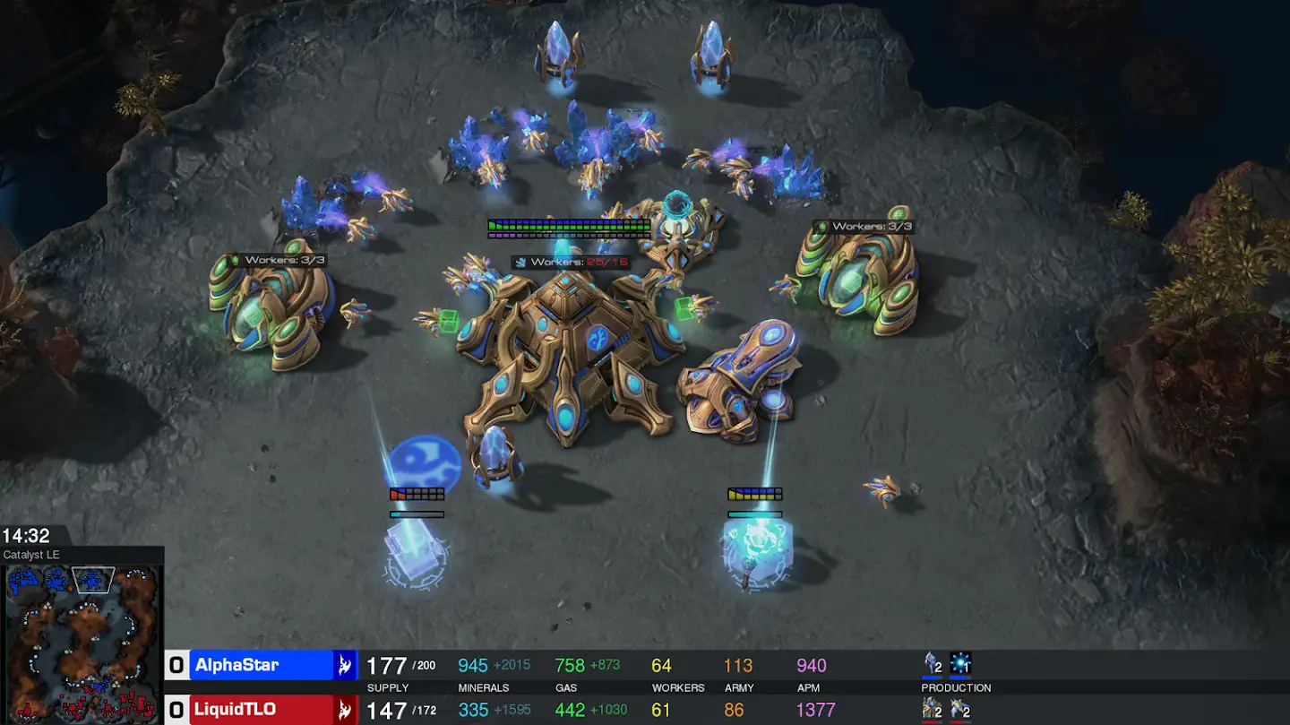
Video Games
Video games are used to test and evaluate the performance of artificial intelligence systems.
In 2019, the AlphaStar program defeated a top professional player in StarCraft that was considered to be one of the most challenging Real-Time Strategy (RTS) games.

Slide 44
Notice that all previous efforts and successes of DL lie in
image classification.
Computers are now enabled to gain high-level understanding from digital images or videos.
This prompts you to ask the question…
Can machines be used to automate the human visual system ?
Let’s find out!

Slide 45
Self-Driving Cars

Slide 46
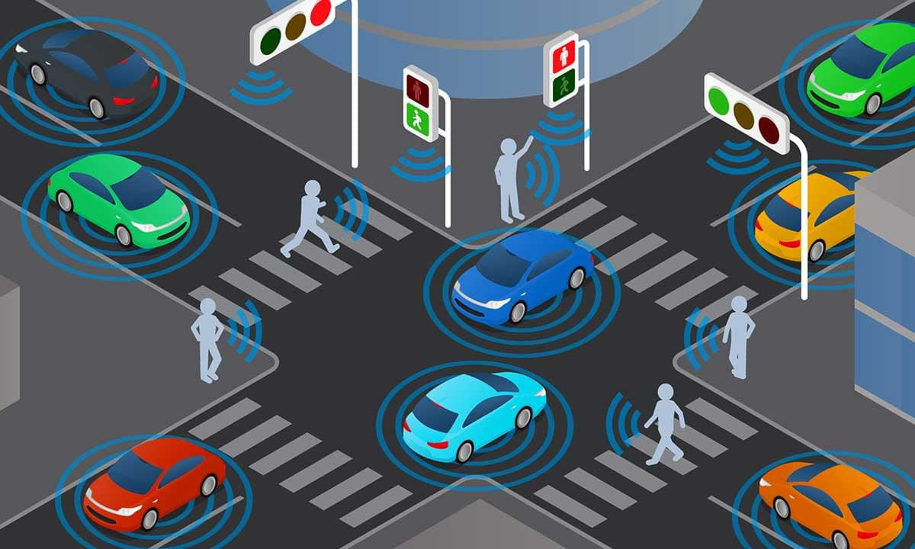
Self-Driving Cars
A self-driving car uses a variety of cameras and sensors to perceive its surroundings and moves safely with little or no human input.

Slide 47




Why the Excitement for Self-Driving?
Self-driving vehicles will be a significant innovation in transportation since they can radically transform how people and goods move around.
Autonomous vehicles will help blind, elderly, and disabled people to move independently, regardless of distance.
Self-driving trucks can drastically reduce delivery times and accidents. Driver and maintenance costs will also reduce.

Slide 48





Advantages of Self-Driving
Less stressful driving
Reduced crash rates
Energy efficiency
Automated lane changes, parking, and braking
Driver error causes 90% of all crashes
Improved fuel efficiency
Ease traffic congestion
Over the air updates
Better coordinated traffic leads to less congestion
Neural nets get better with more data

Slide 49


Levels of Driving Automation
The Society of Automotive Engineers (SAE) has defined five levels in the evolution of autonomous driving.
The 5 levels of driving automation
For on-road vehicles
Human driver
Automated system
Steering and
Acceleration/
deceleration
Monitoring
of driving
environment
Fallback when
Automation
fails
Automated
system is in
control
0
NO AUTOMATION
N/A
Human driver
Monitors the road
SOME
DRIVING
MODES
1
DRIVER
ASSISTANCE
2
PARTIAL
AUTOMATION
SOME
DRIVING
MODES

Slide 50
Levels of Driving Automation
SOME
DRIVING
MODES
3
CONDITIONAL
AUTOMATION
SOME
DRIVING
MODES
4
HIGH
AUTOMATION
Automated driving system
monitors the road
5
FULL
AUTOMATION
Source: SAE International

Slide 51
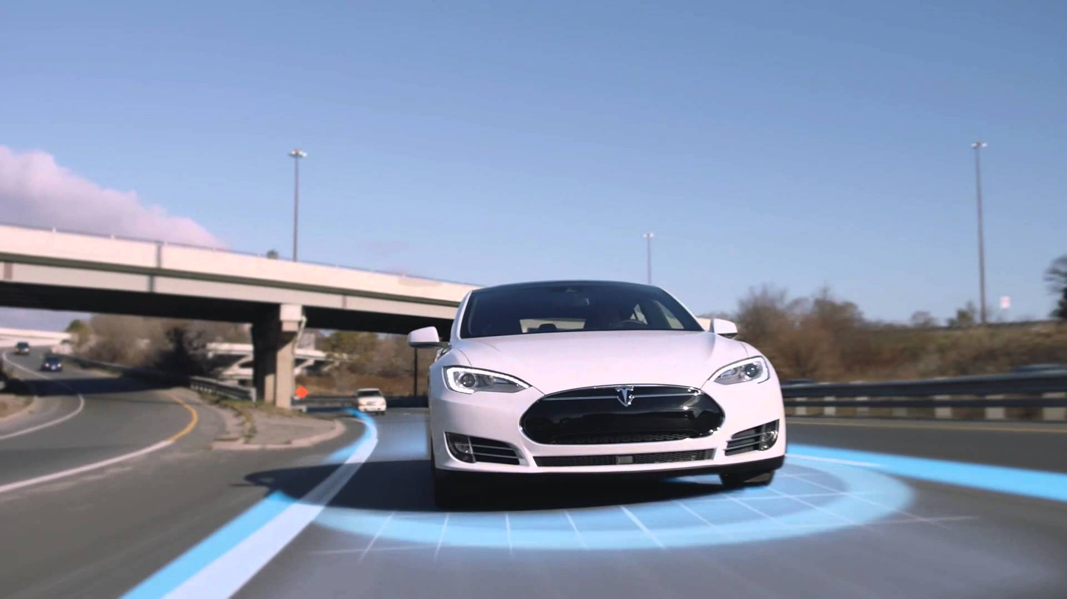
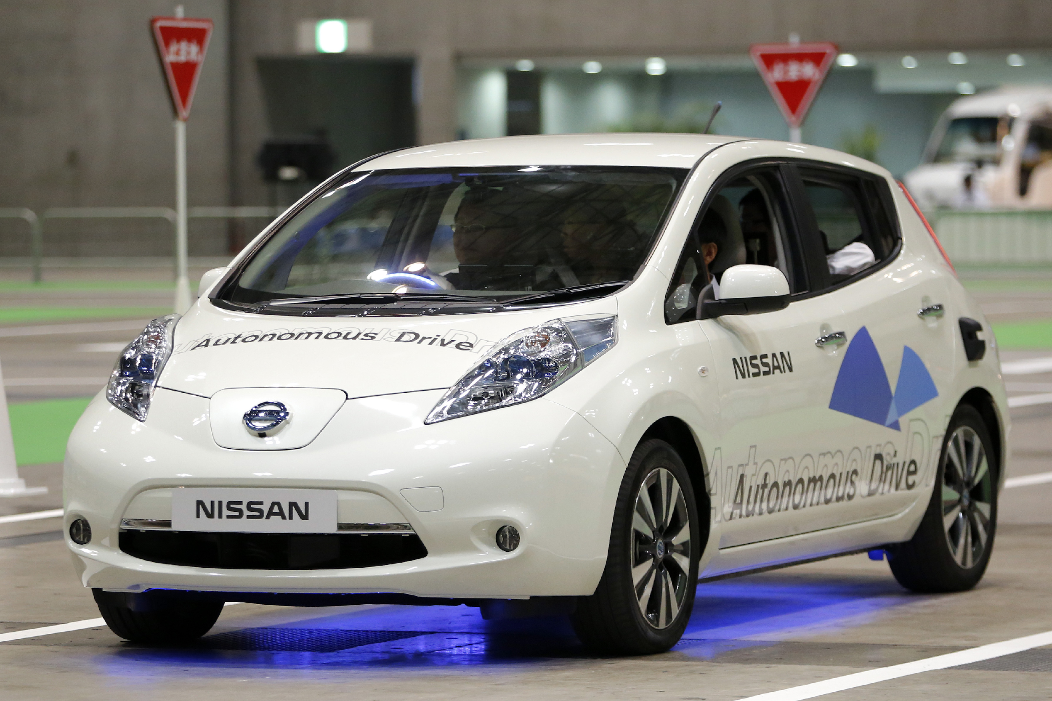
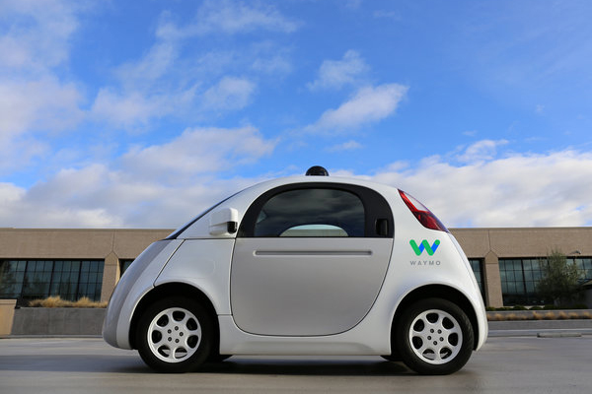
Industry Trends
Various self-driving technologies have been developed by leading companies and major automakers.
Tesla
Nissan
Google Waymo
Presently, self-driving cars are at Level 3 technology.

Slide 52
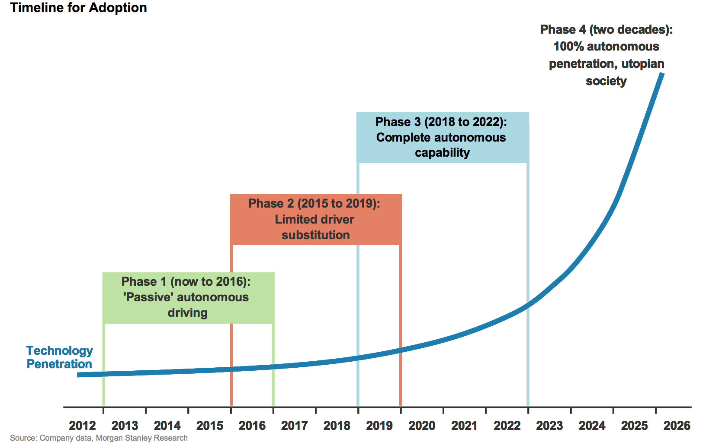
Timeline for Adoption
Automobile industry expects a significant rise in cars with some self-driving capacity on the road by the early 2020s.

Slide 53
Working of Self-Driving Cars

Slide 54
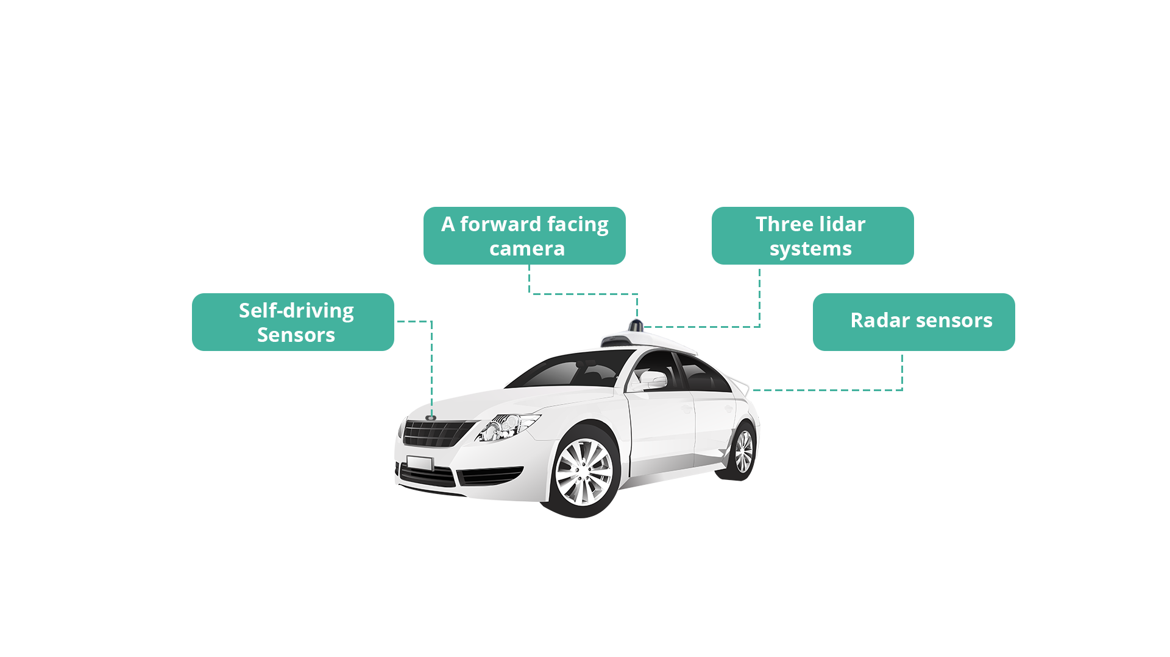
How Does a Self-Driving Car See?
1
Using high-powered sensors and cameras, the vehicle creates and maintains a map of its environment.
A powerful onboard computer processes the information in a matter of milliseconds using hard-coded rules and obstacle avoidance algorithms.
Self-driving sensors
2
3
Then, it plots the route and sends instructions regarding vehicle's steering, acceleration, and braking.

Slide 55
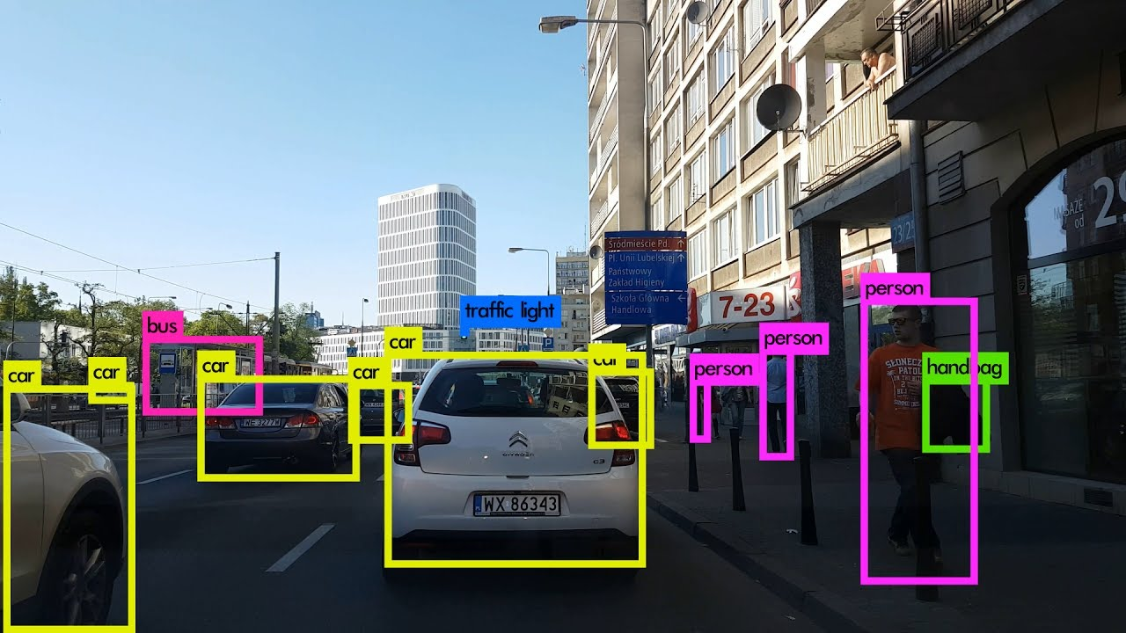
How Does a Self-Driving Car See?
Precise detection of vehicles, pedestrians, and street signs help cars drive as safely as humans.
Detecting moving objects in video streams is a promising and challenging task for modern developers.

Slide 56
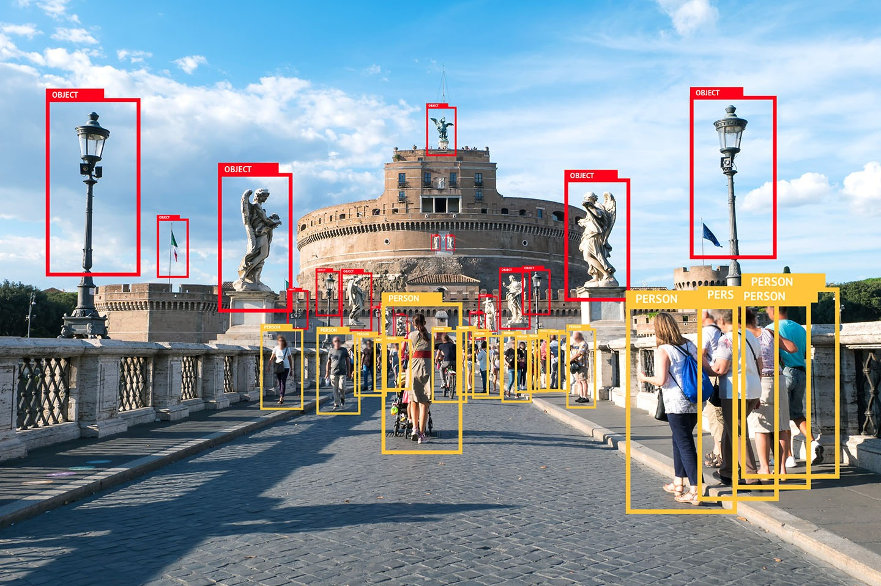
Object Detection
Object detection is used to identify and classify several items with high precision.

Slide 57
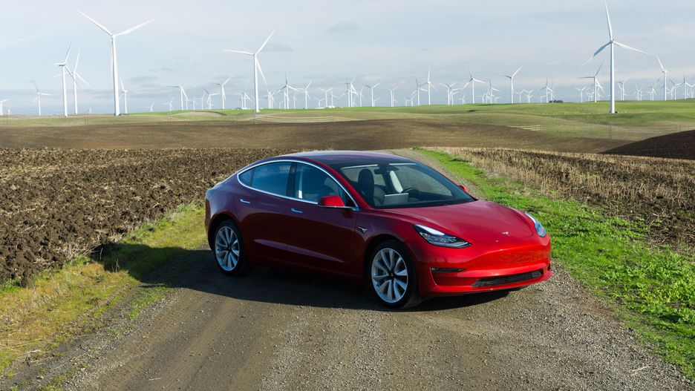
Object Localization
Object localization relates to the location of an object in the picture.
(0,0)
bh
(bx, by)
bw
(1,1)

Slide 58
Bounding Boxes
The following parameters are used to initialize a bounding box:
bx, by
Center coordinates of the bounding box
bw
Width of the bounding box
bh
Height of the bounding box
An algorithm provides the coordinates of the object as the output is based on the picture in the bounding box.

Slide 59
Challenges in Self-Driving

Slide 60
Challenges in Self-Driving
Detecting objects is a challenging task since images of objects in the real-world environment are affected by various factors.
Illumination
Camera Problems
Object Appearance
Challenges
Occlusion
Unpredicted Motion

Slide 61

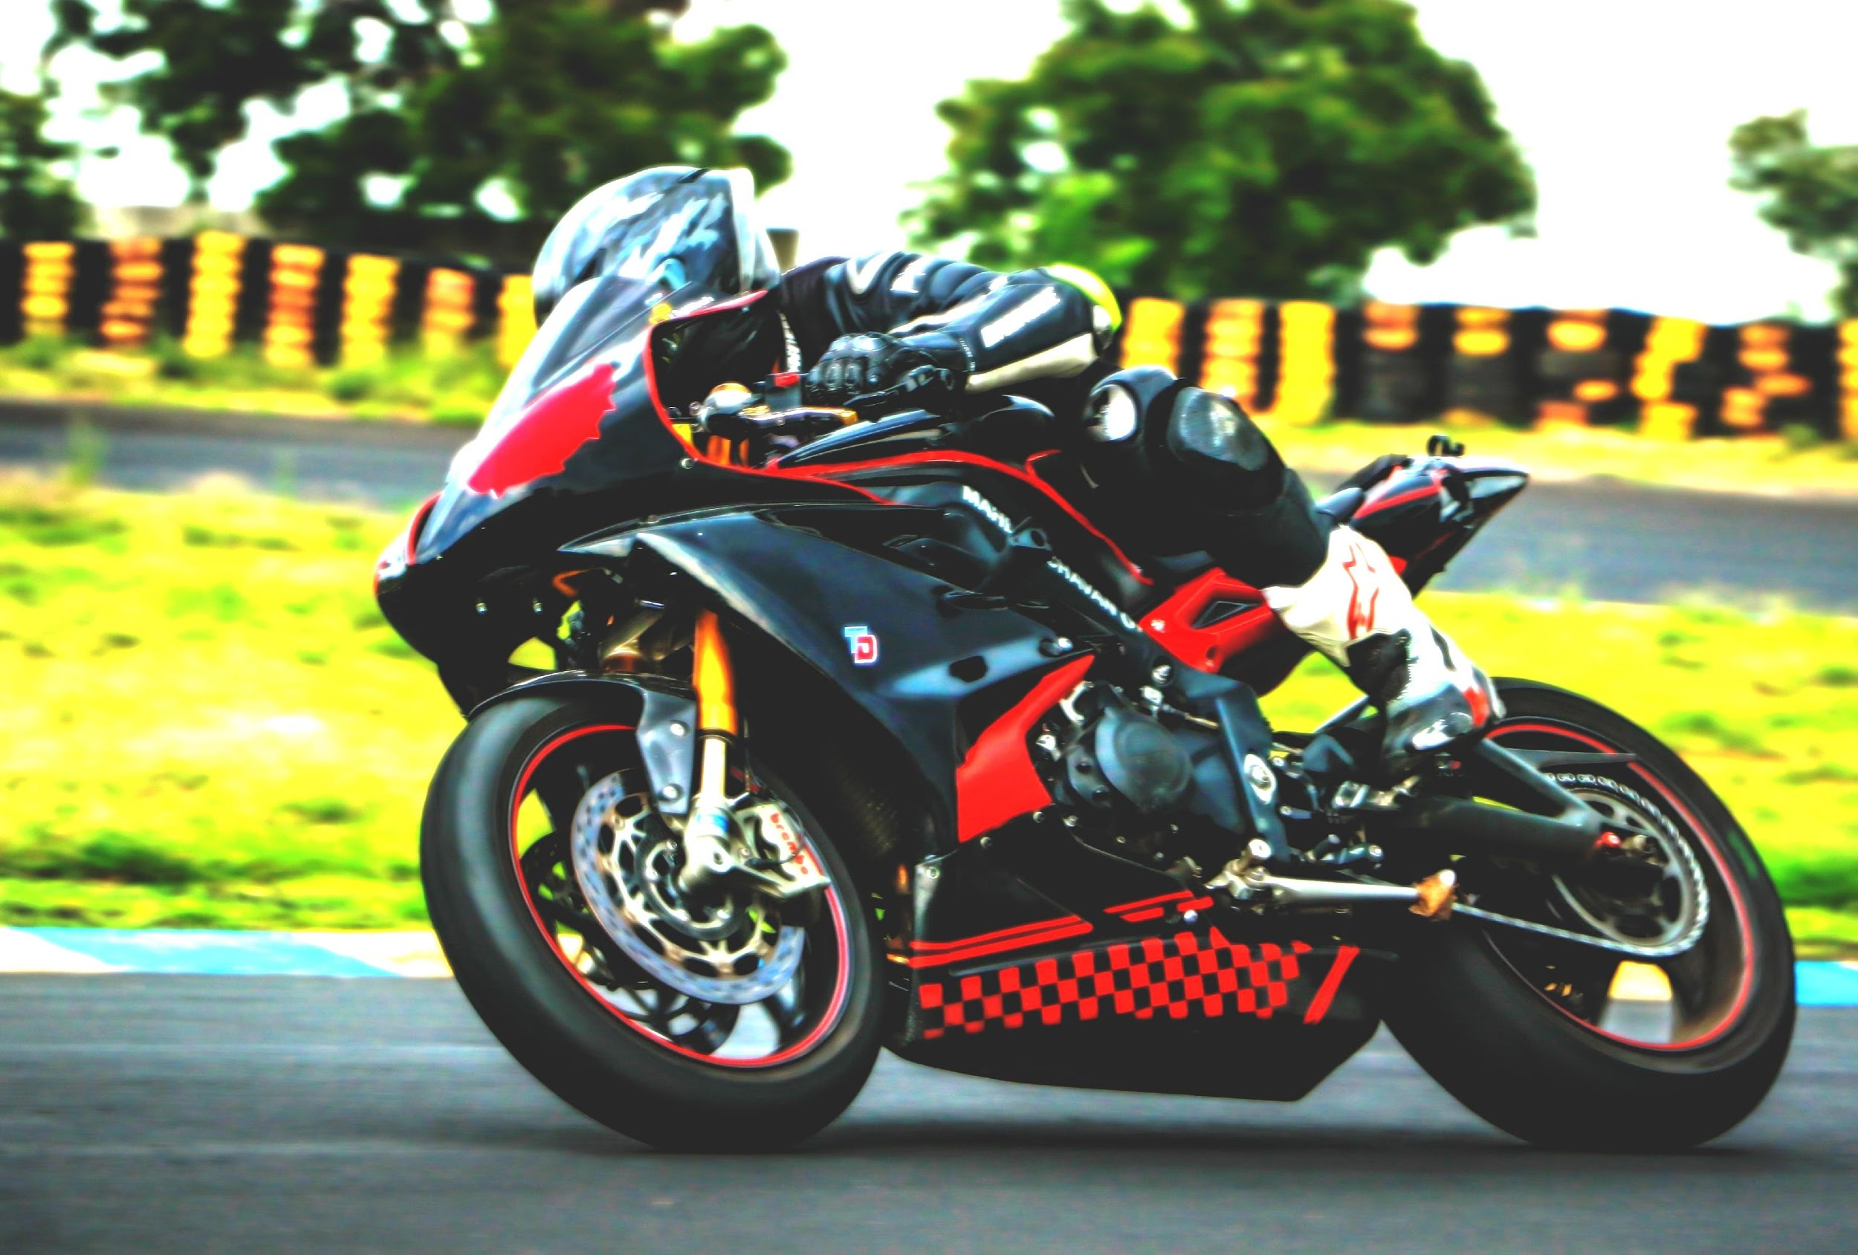
Illumination
Changes in lighting can lead to false positive object detection.

Slide 62

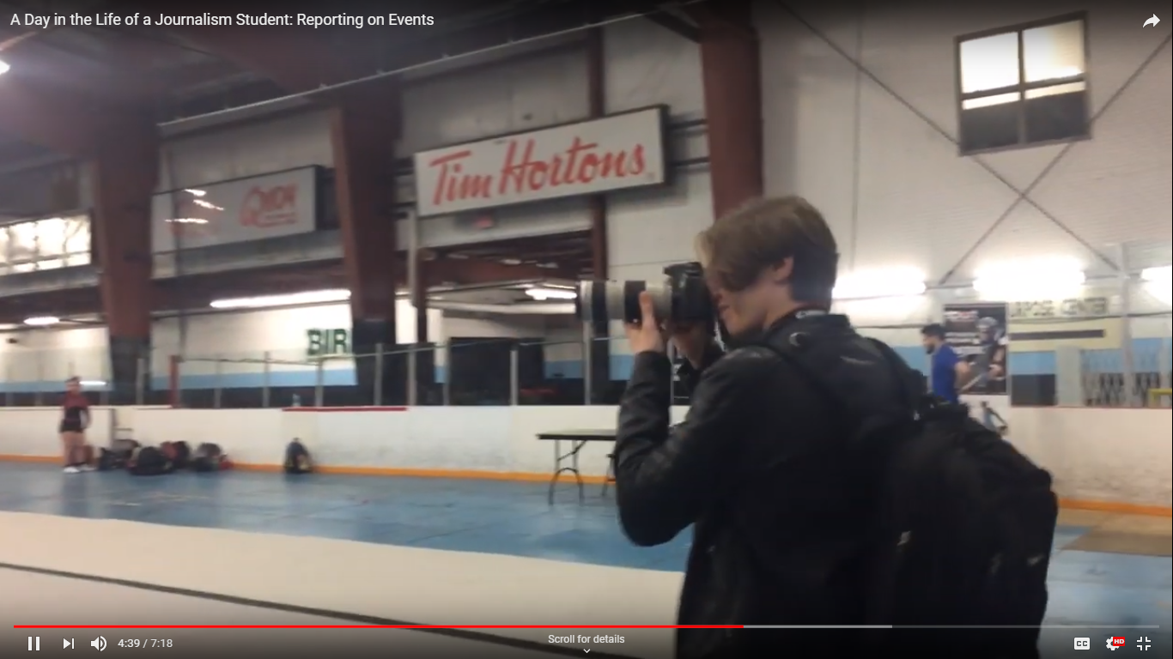
Appearance of Moving Objects
3D objects may change their shape and appearance when in motion.

Slide 63
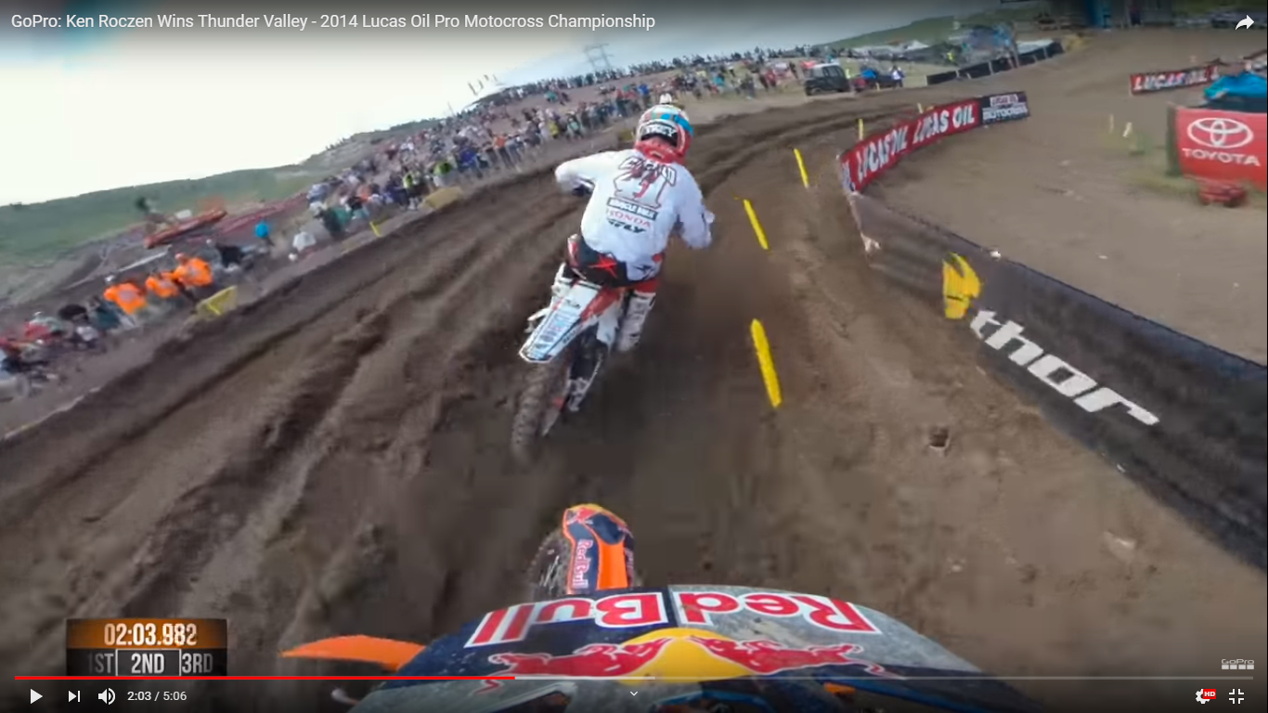
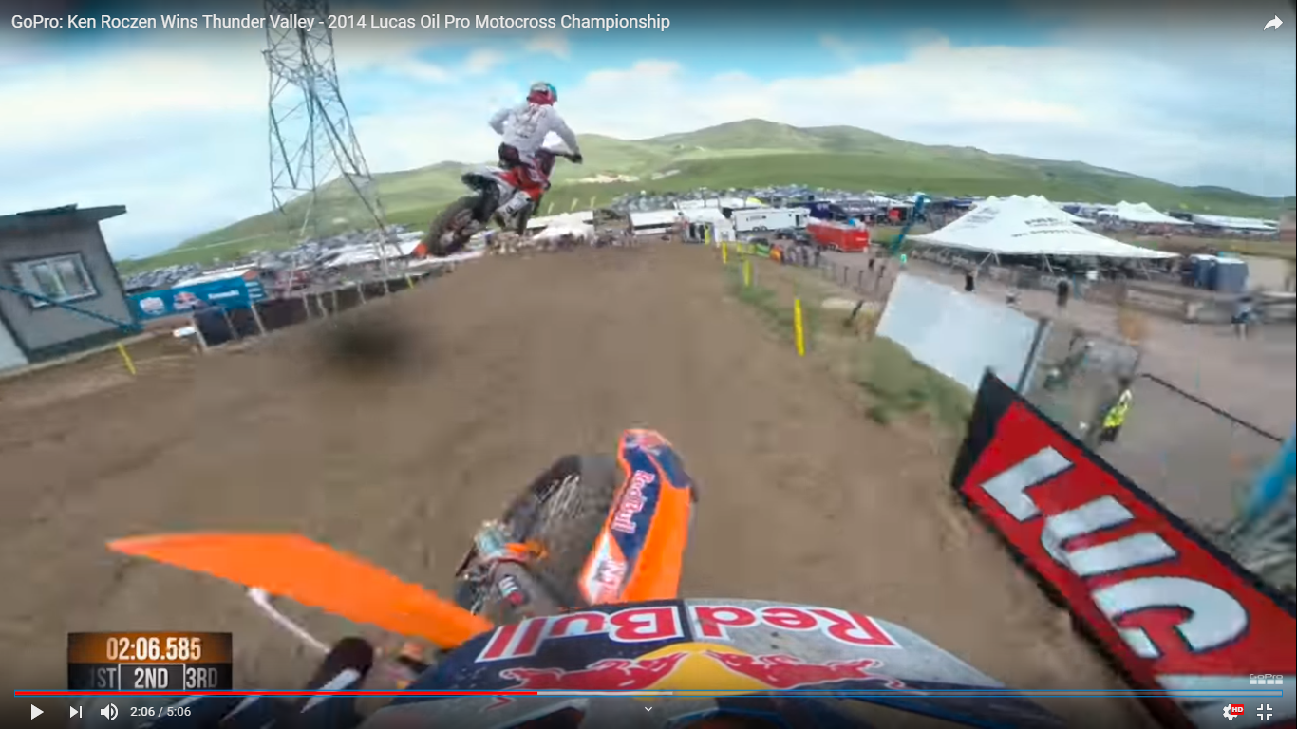
Presence of Unpredicted Motion
Detecting objects with abrupt motion may cause a tracker to lose the object or cause an error in the tracking algorithm.

Slide 64
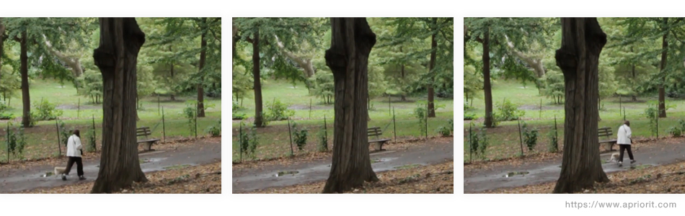
Occlusion
Objects in a video stream may be hidden fully or partially.

Slide 65
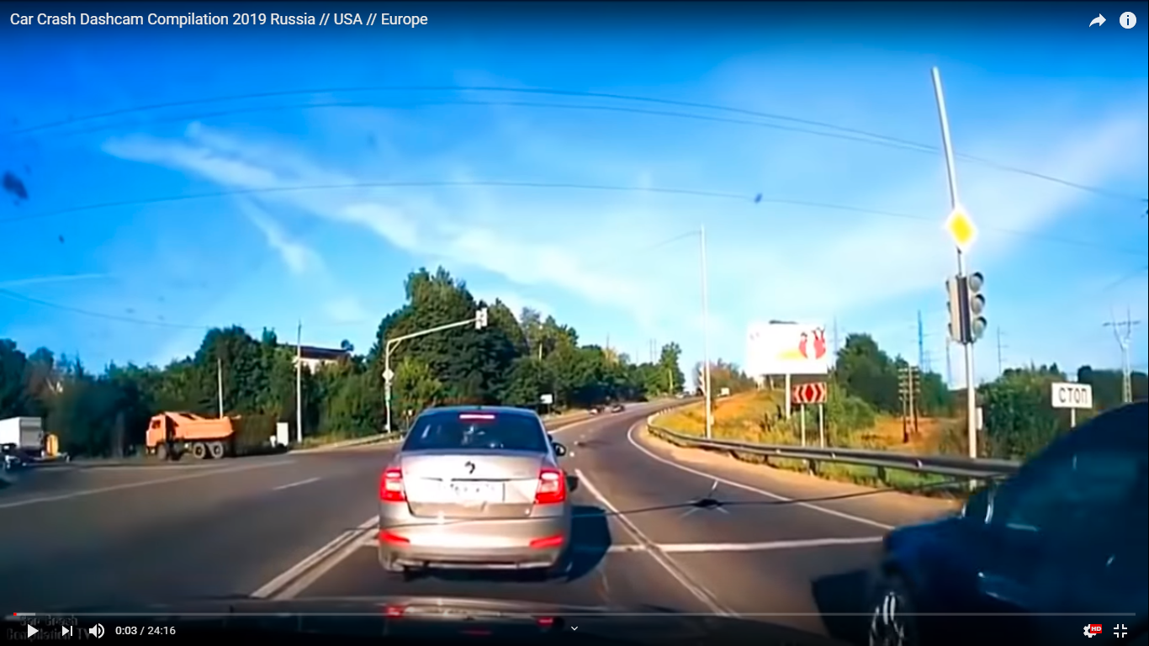
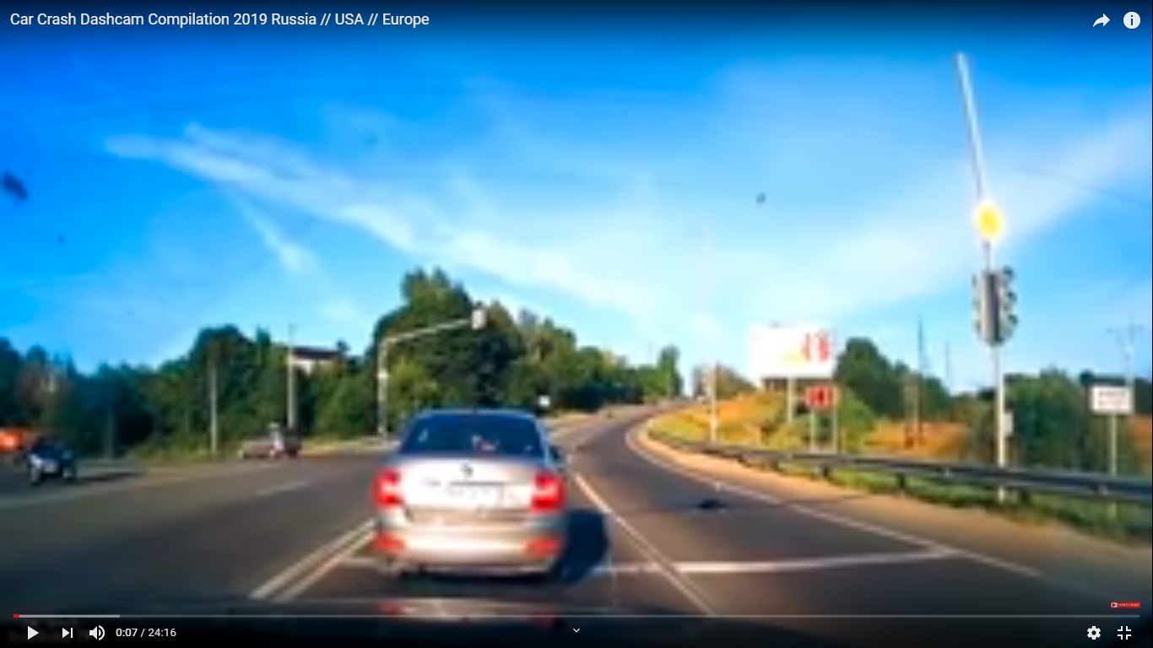
Camera Problems
The captured video may be of low resolution having limited color information.
As a result, a video sequence may not be processed properly due to compression or blur.

Slide 66
Good News !!
Fortunately, neural networks provide you with many possibilities to improve the accuracy of moving object detection as they provide access to greater computational resources.
In recent years, many classification-after-localization methods based on Convolutional Neural Networks (CNN) have improved detection results in various conditions.
We will look into these concepts in chapter 5.

Slide 67
Applications of Deep Learning

Slide 68









Applications
Computer Vision
Machine Translation
Social Network Filtering
Healthcare
Gaming
Self-Driving

Slide 69







Computer Vision
The field of computer vision uses deep learning neural network methods to solve challenging problems such as:
Facial Recognition
Augmented Reality
Gesture Recognition
Image Classification

Slide 70

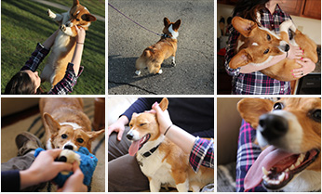
Computer Vision
Advances in image recognition have made it easy to search or automatically organize collections of photos with no identifying tags.

Slide 71
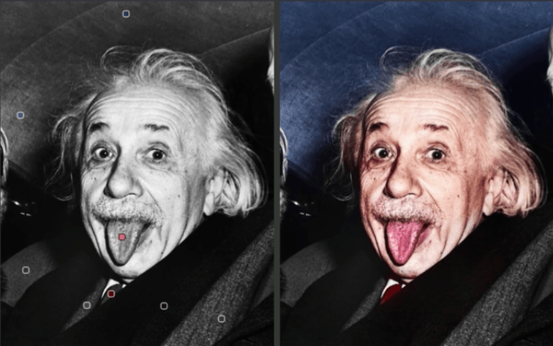
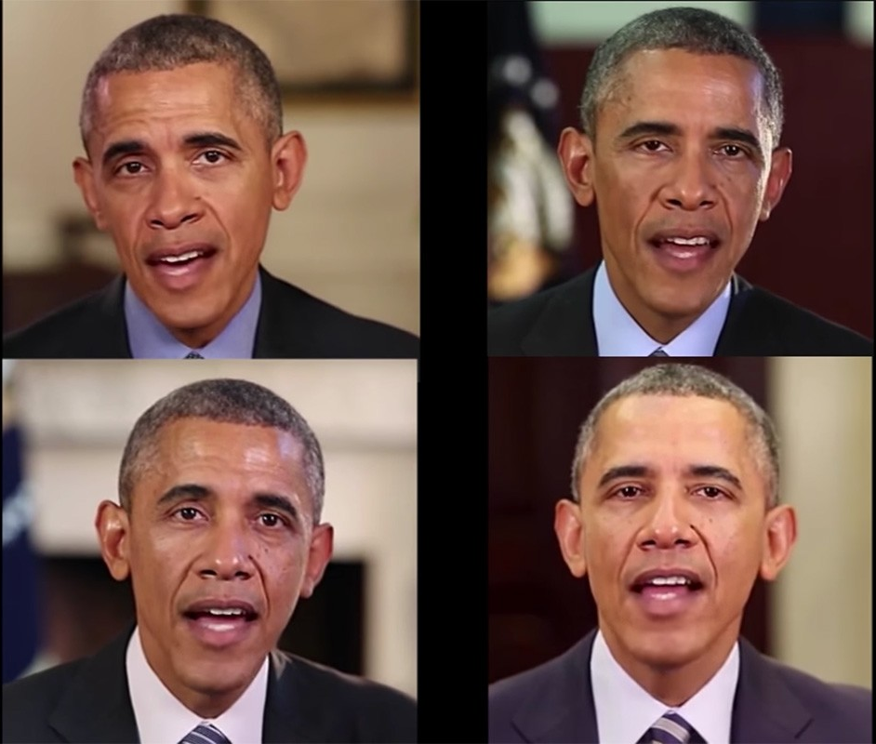
Computer Vision
It is now possible to restore old, black and white images and generate artificial videos with accurate lip syncs.
Automatic Colorization
Deep Fakes

Slide 72


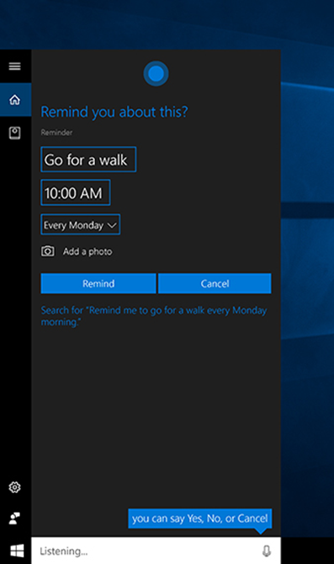
Machine Translation
Advanced neural network algorithms are being used to synthesize text into a variety of voices and languages.
Recent stats shows that speech recognition functions on digital assistants work better than before and customers have almost tripled their use of speech interfaces.

Slide 73
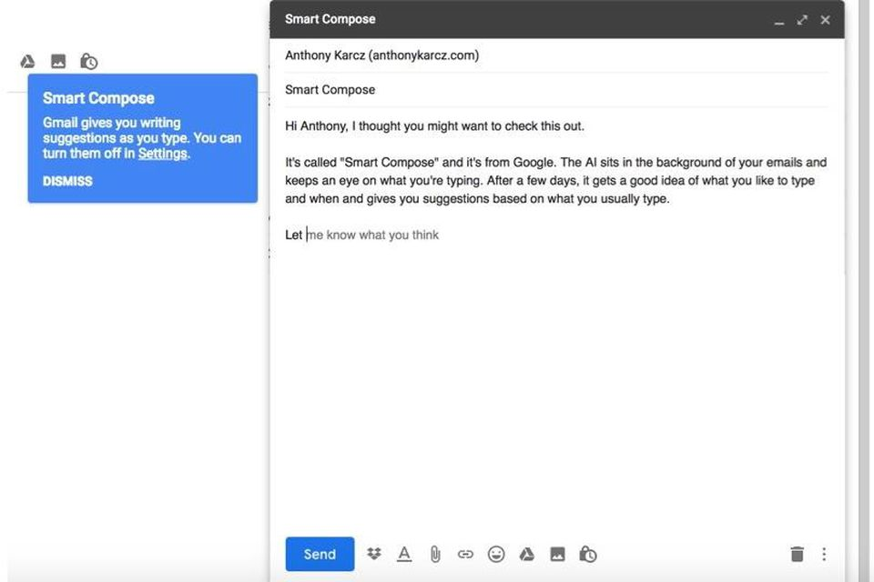

Machine Translation
Automatic text generation is being used to generate customized texts and translate foreign languages.
Gmail Auto-complete
Auto-translate

Slide 74
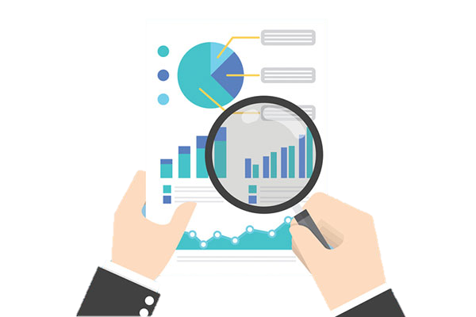
Healthcare
DL methods can draw correlations by analyzing millions of data points and enable clinical physicians to keep pace with current research and treatment protocols.

Slide 75
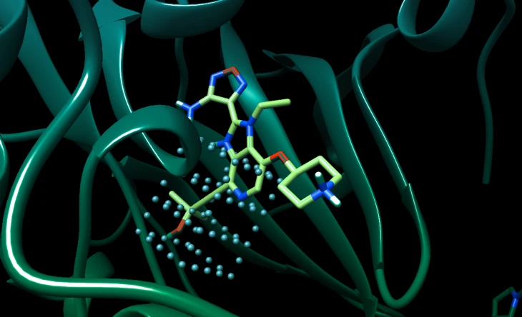
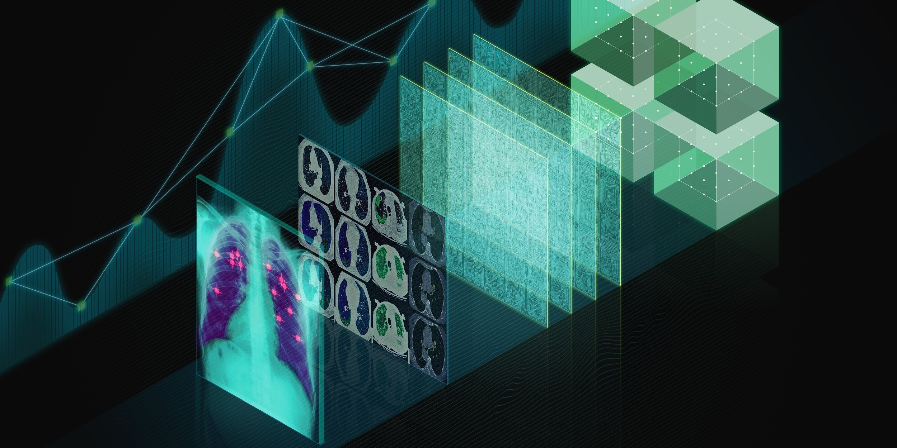
Healthcare
Deep learning will reshape the healthcare industry by providing computer-aided detection and diagnosis.
Drug discovery and precision medicine
Imaging analytics and diagnostics

Slide 76
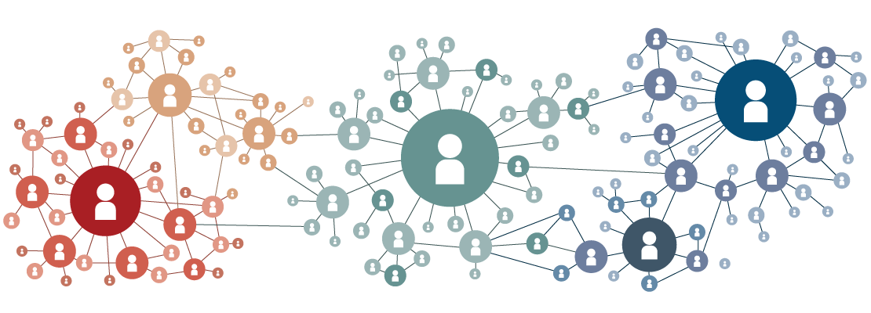
Deep Learning Meets Social Networks
The extensive use of social media platforms creates exciting potential for using neural network models to develop network representations.

Slide 77
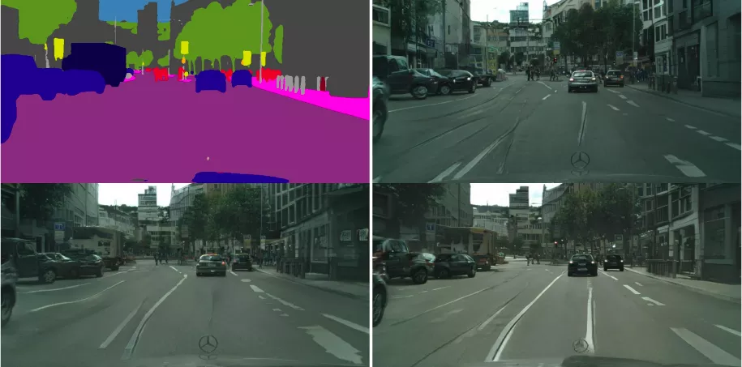
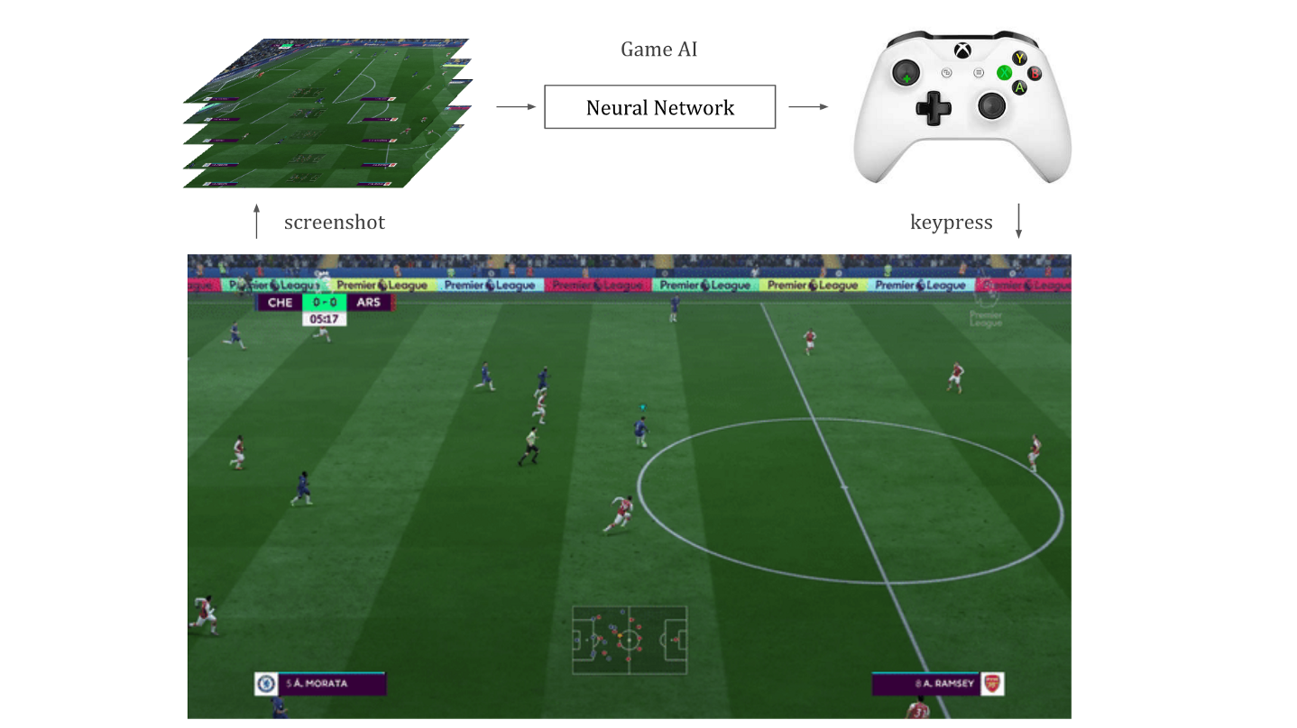
Gaming
DL is being used to dynamically render finer graphic details in games and help game developers to focus on effective storytelling rather than the game graphics.
Dynamic graphics rendering
Neural net playing FIFA
Development of human-like bots is one of the promising DL tools to enrich the gaming experience.

Slide 78
Challenges in Deep Learning

Slide 79
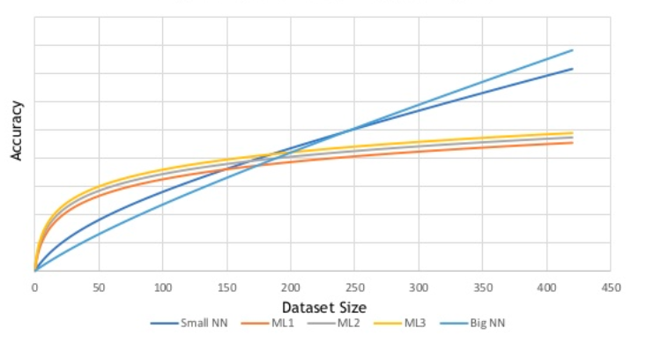
Training Data
Deep learning gives accurate predictions with right quantity and quality of training data.
Accuracy increasing with dataset size
Building a DL model involves time-consuming tasks like collecting and labeling the training data.

Slide 80

Effective Learning and Teaching
Humans can learn from very few examples whereas machines need thousands or millions of examples.
We cannot give every possible labeled sample of a problem space to a DL model. So, the DL model generalizes or interpolates to classify any data not contained in its original dataset.

Slide 81


Understanding Context
Deep learning doesn’t understand context very well as it lacks pure perception.
Visual Understanding is Harder
What’s on people’s minds?
Mirrors
image classification ≠ scene understanding

Slide 82
The Black Box Problem
Neural networks do not rely on rules established in advance. They find out patterns and correlations without exposing the reasons leading to them.
Black Box
Inputs
Output
Implementation is "opaque" (black)
Human users like to understand how a system made a given decision, as decisions are potential liabilities for domains like finance and medicine.

Slide 83

Large Size Model and Complexity
State-of-the-art deep learning models are easily multi-gigabytes in size and are getting larger.
NEURAL NETWORK COMPLEXITY IS EXPLODING
To Tackle Increasingly Complex Challenges
7 ExaFLOPS
60 Million Parameters
20 ExaFLOPS
300 Million Parameters
100 ExaFLOPS
8700 Million Parameters
2015 – Microsoft ResNet
60 Million Parameters
2016 – Baidu Deep Speech 2
Superhuman Voice Recognition
2017 – Google Neural Machine
Tanslation
Nera Human Language translation
Number of parameters are directly proportional to the amount of information absorbed by the neural net.

Slide 84

Infrastructure
Majority of the useful deep learning problems activate the entire neural network for each batch size thereby blowing up the computation costs.
Therefore, models are loaded and scaled on multiple machines.

Slide 85
Long Short-Term Memory (LSTM)

Slide 86
Long Short-Term Memory (LSTM)
Long short-term memory (LSTM) is a recurrent neural network (RNN) that selectively remembers patterns for long durations of time.
Output
LSTM units
Input
LSTMs are mainly utilized in sequence prediction problems such as speech, images, and video.

Slide 87

Role of Memory
LSTMs have memory and take the order of observations into account.
What comes next?
LSTMs need to remember the past to predict the future. Therefore, LSTMs learn any temporal dependence between observations.

Slide 88
Role of Context
Context Not Required
The largest living land animal is elephant.
It is obvious the next word is going to be elephant.
Context Required
I grew up in Germany. I speak fluent German.
Context is required to predict the language.

Slide 89

LSTM Unit
A LSTM unit is composed of a cell and three gates which control the flow of information.
LSTM Cell

Slide 90
LSTM Applications: Sentiment Analysis

Slide 91

Sentiment Analysis
Sentiment analysis involves using computers to understand opinions about a subject from a given piece of text.
Sentiment analysis has become a key tool for making sense of huge amounts of data generated every day.

Slide 92
LSTM Architecture for Sentiment Analysis
Output
Probability
Sigmoid
Sigmoid
Sigmoid
Sigmoid
LSTM
LSTM
LSTM
LSTM
Embed
Embed
Embed
Embed
122
26
3
298
Tokenize
The
food
was
awesome

Slide 93
Step 1: Tokenization
Tokenization consists of splitting the text into smallest meaningful units and converting them into tokens (integers).
122
26
3
298
Tokenize
The
food
was
awesome

Slide 94
Step 2: Embedding
The embedding layer converts word tokens into embedding vectors of specific size.
Embed
Embed
Embed
Embed
122
26
3
298
The sequence of words encode lots of information that are useful to predict sentiment.

Slide 95
Step 3: LSTM
The embedding vectors are passed on to LSTM layers in a recurrent manner.
LSTM
LSTM
LSTM
LSTM
Embed
Embed
Embed
Embed
122
26
3
298
Tokenize
The
food
was
awesome
The layers add recurrent connections to the network to include information about the sequence of words in the data.

Slide 96
Step 4: Sigmoid Function
The sigmoid activation function outputs a binary value to classify the sentiment. For example, positive or negative sentiment.
Sigmoid
Sigmoid
Sigmoid
Sigmoid
LSTM
LSTM
LSTM
LSTM
Embed
Embed
Embed
Embed
122
26
3
298
Tokenize
The
food
was
awesome
The last prediction is considered as the output sentiment.

Slide 97
Life Cycle of a Deep Learning Project

Slide 98

Life Cycle
Deep learning projects are iterative in nature and consist of tasks given below.
Project Planning
Data Collection
and
Labeling
Model Building
Deploying and Monitoring
It is advised to build smaller models with few data points and increase the complexity as time goes by.

Slide 99



Project Planning
Project planning includes defining goals, metrics, and baselines.
Reduce cost by giving cheap predictions
Define project goals
Choose metrics
Evaluate baselines
Set up codebase
Automate manual software pipeline

Slide 100
Questions to Ask
01
Problem Difficulty
Any good published work on similar problems?
Are resources available for training and deployment?
Accuracy Requirement
02
How costly are wrong predictions ?
How frequently does the system need to be right to be useful?
03
Data Availability
How hard is to acquire data ?
How expensive is data labeling?
How much data will be needed?

Slide 101
Data Collection and Labeling
In this step, data is collected, stored, and labeled using various tools.
How can I obtain the complete dataset?
Web Scraping
Data Labeling Tools
Strategy
Ingest
Labeling
Crowdsourcing
AWS Storage
Private Companies

Slide 102
Model Building
Model building activities include training, testing, and debugging.
Tune
Hyperparameters
Start Simple
Implement and
Debug
Evaluate
Meets
Requirements
Improve Model
or Data

Slide 103



Deployment and Monitoring
Once the model meets the requirements, it is deployed and monitored using the desired interface.
Web Server Deployment
Monitoring

Slide 104
Now, you are able to:
Describe artificial intelligence and deep learning
Outline the history of artificial intelligence
List successes of deep learning
Discuss object detection using self-driving cars
Discuss the applications of deep learning
Outline the full cycle of a deep learning project

Slide 106
In which of the following problems can we use deep learning ?
1
New drug discovery
Self-driving
Pattern classification
All of the above

Slide 107
In which of the following problems can we use deep learning ?
1
New drug discovery
Self-driving
Pattern classification
All of the above
d
All of the mentioned problems can be solved using deep learning.

Slide 108
Which of the following best compares human and machine intelligence ?
2
Humans have sense organs
Humans have better IQ and intellect
Humans perceive everything as a pattern while machines perceive it as data
Humans have emotions

Slide 109
Which of the following best compares human and machine intelligence ?
2
Humans have sense organs
Humans have better IQ and intellect
Humans perceive everything as a pattern while machines perceive it as data
Humans have emotions
c
Humans have a tendency to see patterns and make decisions, while a machine makes its decision based on data.

Slide 110
Which of these are reasons for increase in popularity of deep learning?
3
Access to greater computational power
Access to large amounts of data
Significant improvements in image classification and recognition
All of the above

Slide 111
Which of these are reasons for increase in popularity of deep learning?
3
Access to greater computational power
Access to large amounts of data
Significant improvements in image classification and recognition
All of the above
d
In recent years, deep learning has become more popular due to access to large amounts of data and computational power along with significant improvements in image classification and recognition.

Slide 112
Which of the following statements are true ?
4
Bringing more data to a model is almost always beneficial
Big networks usually perform better than small networks
Both a and b
None of the above

Slide 113
Which of the following statements are true ?
4
Bringing more data to a model is almost always beneficial
Big networks usually perform better than small networks
Both a and b
None of the above
c
Increasing the training set size and the size of a neural network significantly improves the performance.

Slide 114
Which of the following algorithms is best suited to train a model to play chess ?
5
Supervised Learning
Unsupervised Learning
Reinforcement Learning
Deep reinforcement Learning

Slide 115
Which of the following algorithms is best suited to train a model to play chess ?
5
Supervised Learning
Unsupervised Learning
Reinforcement Learning
Deep reinforcement Learning
d
Reinforcement algorithms that incorporate deep learning are best suited for training models to play games.

Slide 116
Thank You

